Slide 1
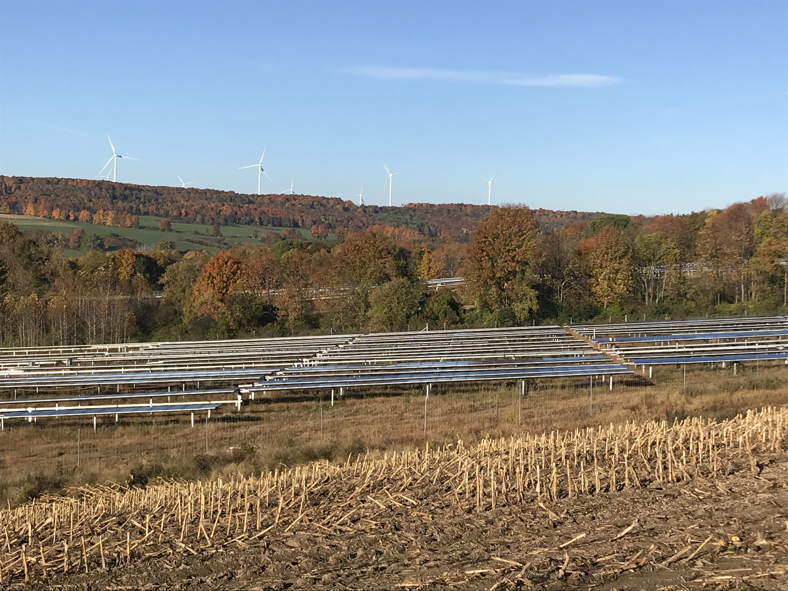
Hosting Renewable Energy Projects
Optimizing Community Benefits
Joe Lawrence
July 2025

Slide 2
NYS Agriculture
Last 25 years: 1,285,955 acres left agriculture in NYS
  Returning low productivity land to nature has many ecological benefits
    can have economic consequences to local economies
  Loss of high productivity land challenges the environmental viability of our food system & viability of local economies reliant on agriculture
Census Year | NYS Farm Numbers | Market Value of Ag Products Sold, $ | NYS Land in Farms, acres | 5 year change, acres
2022 | 30,650 | 8,037,292,000 | 6,502,286 | -363,885
2017 | 33,438 | 5,369,212,000 | 6,866,171 | -317,405
2012 | 35,537 | 5,415,125,000 | 7,183,576 | +8,833
2007 | 36,352 | 4,418,634,000 | 7,174,743 | -486,226
2002 | 37,255 | 3,117,834,000 | 7,660,969 | -127,272
1997 | 38,264 | 2,930,569,000 | 7,788,241
Notes:
2022 inflation adjustment (from 1997) = $5,178,000

Slide 3
Lewis County
Rural county
Legacy industries struggling
Support for Renewable Energy
Future economic health is based on our natural resources
  Dairy Industry remains critical contributor to local economy
Prime soils are a finite resource for food production
Prime Agricultural Land vs. Open Space Considerations
Prime Soils → Food Production
Marginal Soils → Solar

Slide 4
Local Experience
“Don’t use
grant money
to buy groceries”
Energy Development offers an infusion of funds
PILOT (Payment in Lieu of Taxes)
Initial wind project PILOT (Lewis Co.)
    Some municipalities used funds for investment while continuing to gradually increase taxes
    Others used funds to keep taxes artificially low
      Scrambling now
Growing discrepancy in county (have and have nots)
  Rural county – population trending down

Slide 5
Renewable Energy in Rural Economies
“In some rural counties, clean energy is the largest new source of economic activity, helping stabilize local economies otherwise reliant on agriculture’s unpredictable income streams.”
“For example, in Howard County, Iowa, wind turbines generated $2.7 million in property tax revenue in 2024, accounting for 14.5% of the county’s total budget“
How Wind and Solar Power Supports America's Farms
https://www.morningagclips.com/how-wind-and-solar-power-supports-americas-farms/
—Paul Mwebaze, Research Economist at the Institute for Sustainability, Energy and Environment, University of Illinois at Urbana-Champaign, The Conversation

Slide 6
Lewis County IDA
Carrot vs. Stick
Allow Landowner and Developer to still make ultimate decision but provide incentives to avoid prime farmland
  highest PILOT fee for projects on prime soils and actively farmed land.
  Offer discounts for use of marginal soils and/or idle land
  Current Base PILOT - 100% Prime land + actively farmed = $7500/MW
    First iteration started at $5,500/MW
      Based on NY Solar PILOT Toolkit
      Developers didn’t seem to blink an eye
https://naturallylewis.com/growing-opportunities/smart-growth-solar

Slide 7
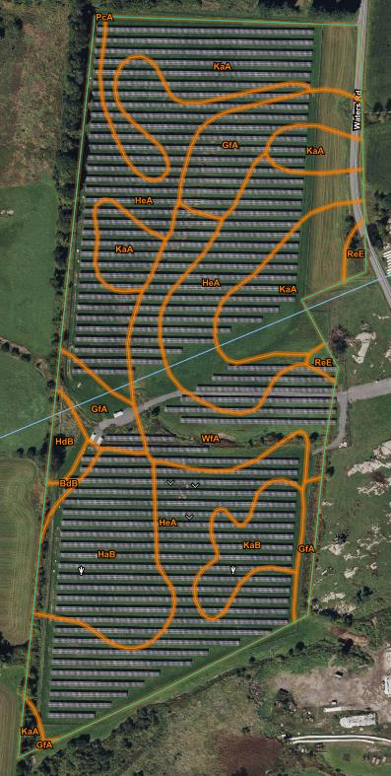
Lewis County IDA
Example PILOT Calculation
Current Base PILOT
  100% Prime land + actively farmed = $7500/MW
  Idle – not farmed in last 18 months
  % of Prime Soils determined by county SWCD
USDA Web Soil Survey: https://websoilsurvey.sc.egov.usda.gov/App/HomePage.htm

Slide 8
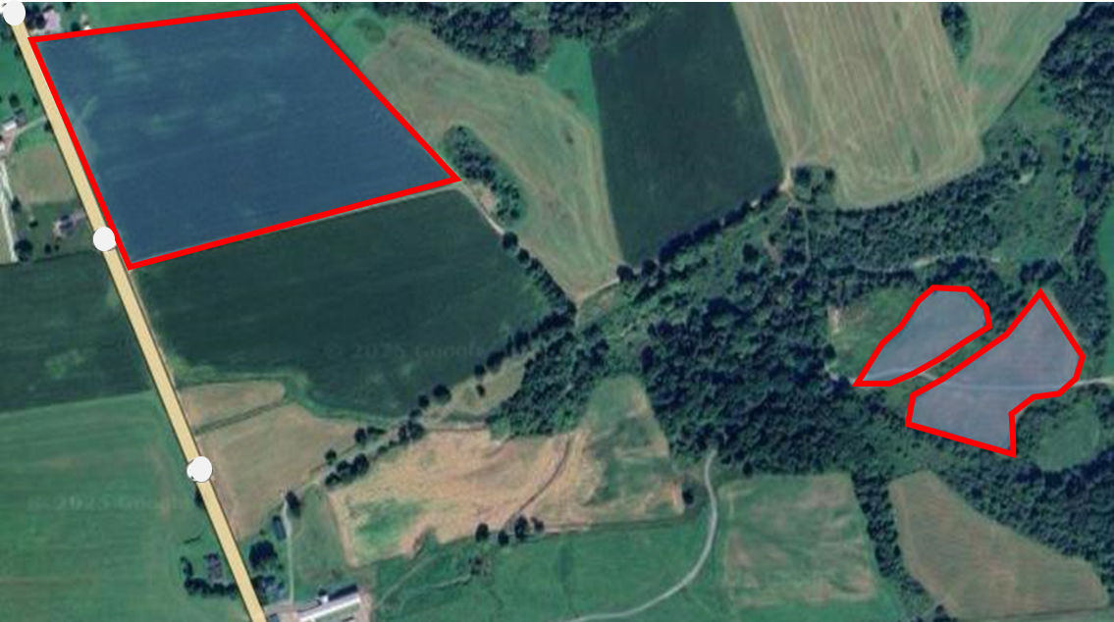
Limitations
Develop cost – influence of PILOT
  PILOT desired to provide budget stability for length of project
  Proportionally smaller expense relative to
    Construction
    Interconnection
Factors attributing to marginal vs. optimal farmland – more than just soil type

Slide 9
    The PILOT “cliff”
Renewable Energy PILOT’s hit differently
Inflation Escalator
????
Decommission Project?
Taxable project remaining?
Re-power and negotiate new PILOT?
Tax Hike Shock?
  2% Tax Cap
End with taxing jurisdictions receiving full tax rate

Slide 10
    PILOT Escalator / De-escalator
Potential Mutual Benefit
????
Taxing Jurisdictions
  Increase revenue up front
    Actual life of project?
  Ease off of the “cliff”
Developer
  Pay less as project gets older
    Higher maintenance / lower revenue
      Less efficient energy production?
????

Slide 11
Why Host Community Benefit Agreements?
PILOT
Tax Revenue
  PILOT “cliff”
  Fund Balances
  Tax base formula aid
HCBA
Negotiated by affected entity
  Taxing Jurisdiction
  Official entity
    Local Development Corporation
    Others……….
  NOT IDA’s
Does not count as tax revenue
  Flexibility
  Grant / Loan programs

Slide 12
Project Development
Who, What, How
Developer needs
Lease agreement
Site plan approval
PILOT (?)
Interconnect agreement
Community Mechanism
Individual Landowner Interest
Zoning
PILOT
HCBA
Key partners at the table
Municipal Officials
County Planning
IDA / Econ. Dev.
Landowners
Cornell Cooperative Extension
Soil & Water Conservation District

Slide 13

Maximizing community benefit
Work to maximize total investment by developer
  United front
    Local players negotiate and develop strategy before
    meeting with developer
  Spell out policy and expectations to developer up front
  Communicate plan for funds to community
  Maximize the size of the “pie” …… Total Spend
  Work together to determine optimum split of the
  pie to maximize community benefits
    Community
    Infrastructure
How do we use energy project revenue to build future tax base?

Slide 14
Maximizing community benefit
Developer Investment in Community
PILOT
HCBA
Special Projects
Etc.
Other factors affecting size of “pie”
Landowner Lease
  Land use tax adjustment compensation
Special District Taxes
Road Maintenance
Zoning Requirements
  Fencing & Screening
  Burying wire
Etc.
Lewis County
PILOT + HCBA
Wind: >$9000/MW
Solar: >$7,000/MW

Slide 15
Host Community Benefit Agreements
Copenhagen Wind Project
  80 MW project
  PILOT $8400/MW
    2.5%/yr ↑, 20 years
Township HCBA
HCBA: $400,000
split over two payments
in 1st 5 years
Town established committee to award grants: WINDENMARK
  Administration?
  Strategic Investment?
  Total $

Slide 16
Host Community Benefit Agreements
Number 3 Wind Project
  103.9 MW project
  PILOT: $8000/MW
    1.5%/yr ↑, 30 years
Countywide HCBA
  Lewis County Development Corp
HCBA: $150,000/yr for 30 years
    1.5%/yr ↑, 30 years
Lewis County Community Economic Development Program

Slide 17
Lewis County Community Economic Development Program
Negotiate to maximize total payment to community
Central administration by Naturally Lewis, Inc.
  Independent committee (appointed by LCDC) reviews grant applications and allocates funds
Community Impact AND Infrastructure
Annual grant programs open to anyone in county
  Small Things, Big Impact Funds
  Building Business Funds
  Community Connection Funds
  Student Pitch Competition
  Business Retention Fund (combo funding)
https://naturallylewis.com/support/funding-opportunities

Slide 18

Host Community Benefit Agreements
Lewis County utilizing this approach for all current and future projects
  Multiply benefits by building on single fund
    Entity with capacity to administer
  Precedent set for what is possible
    Creative collaborations to meet needs of local entities
    Solar has a larger impact on farmland than Wind
  Strategic vision for funds
    Building Tax Base
“Don’t use
grant money
to buy groceries”

Slide 19
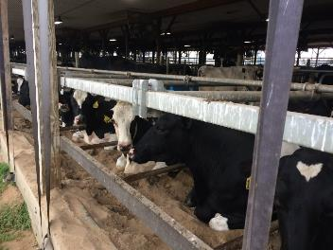
Agriculture & HCBA’s
Soil Type | Yield Index, Corn Grain
Adams | 140 bushel/acre
Croghan | 150 bushel/acre
Nellis | 165 bushel/acre
Source: Cornell University
Solar is competing with Ag land
  Land for food production
  Productivity of land
  Cost of remaining Ag land
  Local Ag Infrastructure
    Critical mass
Funds to keep farms competitive
Protect our most productive land
Enhance land with greater potential
  USDA classification: Prime if Drained
Retain/Maintain Ag Infrastructure
Supply Chain & Markets
  Agrivoltaics?

Slide 20
Thank You!
Joe Lawrence, MSc, CCA
jrl65@cornell.edu

Slide 21

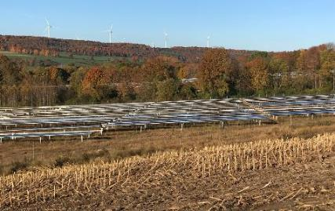
Economic Impact: Dairy & Solar
Dairy
  Tight margins – much (sometimes all) gross revenue spent to maintain farm
  Lewis County: $1 change in milk price = +/- ~$20,000 per day in gross milk income (Yearly swings in milk price can be large [last year: $5 per hundred weight])
  Milk Production
  Soil Productivity
Gross revenue from milk sales
  Economic multiplier of dairy
  One Acre supporting a dairy cow ($4,000-6,000 in economic activity)
Solar
Lease to Landowner (~$1,000 +/-)
Payment in Lieu of Taxes (PILOT)
for local municipalities (~$5000 - $7000/MW……$1,000 +/- per acre)
Temporary Construction Jobs
Notes:
Joe

Slide 22
Economic Impact: Dairy & Solar
Model Inputs
Interactive Spreadsheet
Farm Specific
https://tughill.org/agriculture-solar-calculator/
Notes:
Joe

Slide 23
Potential Cost to Farm
Soil Type | Yield Potential for Corn Silage
Adams | 15.0 tons/acre
Croghan | 16.0 tons/acre
Nellis | 18.5 tons/acre
Source: Cornell University
Finding new land to replace acres lost to solar
  Lower productivity soil
  Still need to feed the same number of cows
    100 acres @ 18 ton/acre → 109 acres @ 16.5 tons/acre
  Road miles traveled to field
  Reduces overall sustainability of food production
    financial
    environmental
Notes:
Joe

Slide 24
“Marginal” Land
Farmers definition of marginal land goes beyond soil type.
  Economic efficiencies
    Distance from farmstead
      Hauling both direction
    Shape of fields
    Field Access
    Neighbor Considerations
  Soils
    Acres per cow
      <2 acres per cow
      >3 acres per cow
    Crop Yield Potential
    Variability in field – manage to lowest common denominator
Notes:
Joe

Slide 25
Economic Impact: Dairy & Solar
Soil Productivity
Model Inputs
Interactive Spreadsheet
Farm Specific
https://tughill.org/agriculture-solar-calculator/
Notes:
Joe

