Slide 1


Legal Considerations for Community Benefits Agreements
Matthew Eisenson
Sabin Center for Climate Change Law
July 30, 2025

Slide 2

What Is a Community Benefits Agreement?
Community Benefits Agreement (CBA) = A legally-binding contract between a project developer and community stakeholders or local government, under which the developer agrees to provide specified community benefits in return for a commitment from stakeholders to support, or not oppose, the project.

Slide 3
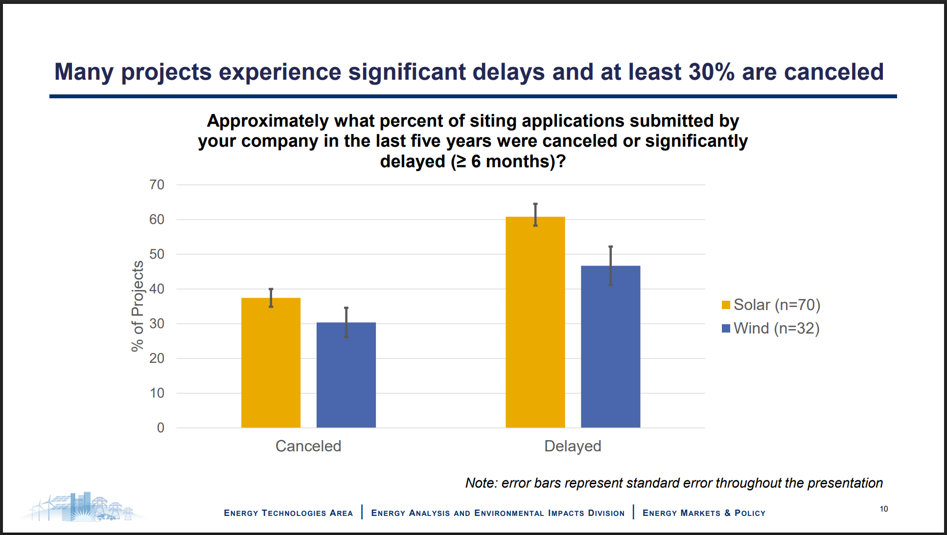
Source: Berkeley Lab (2024)

Slide 4
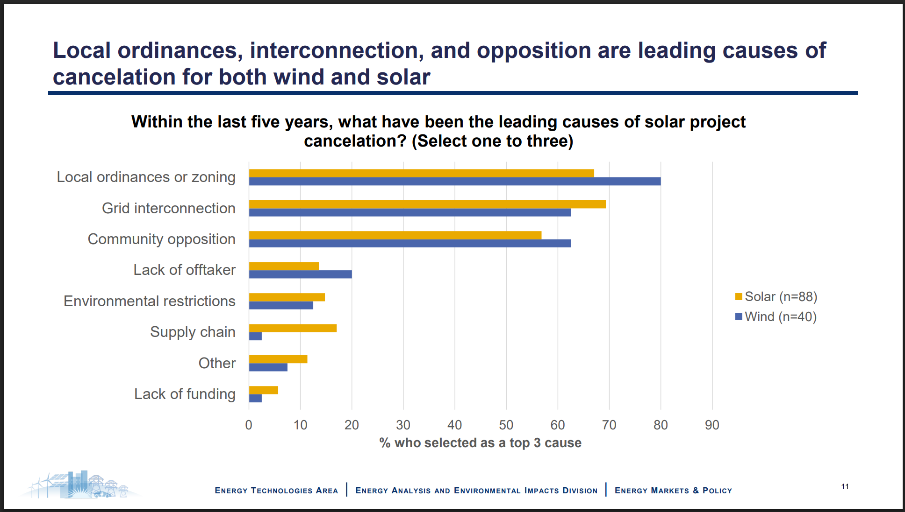
Source: Berkeley Lab (2024)

Slide 5
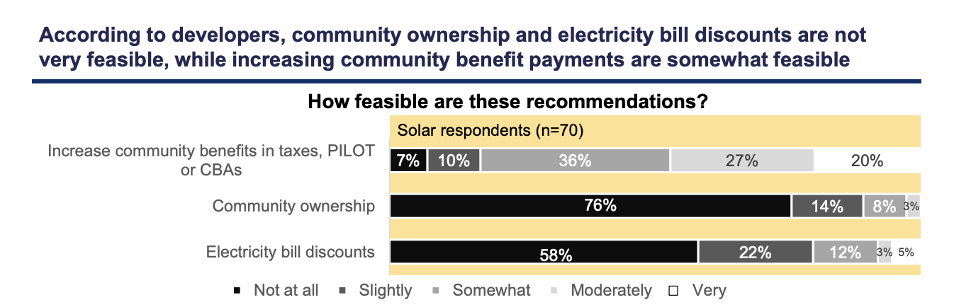
Source: Berkeley Lab (2024)
Notes:
Approximately 83% of developers thought increasing CBAs was at least somewhat feasible, whereas less than 20% thought community ownership or bill discounts were feasible.

Slide 6
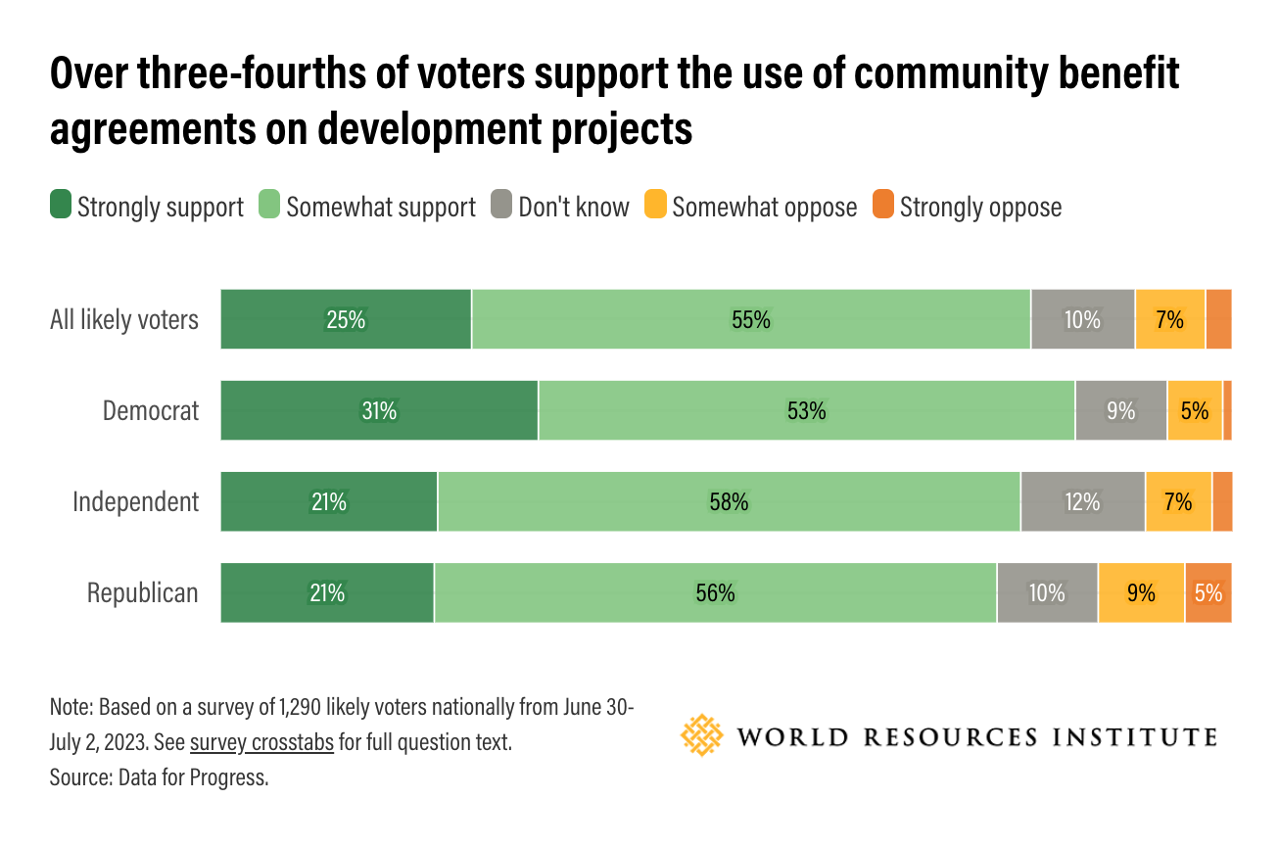
Source: WRI (2023)

Slide 7

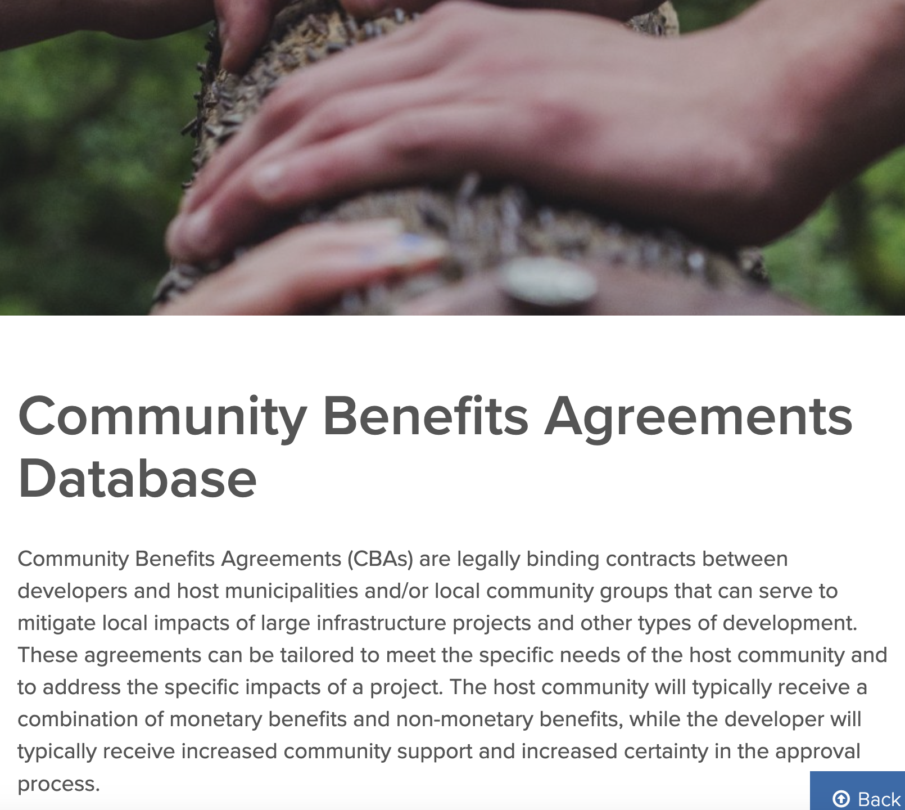
Resources & Publications

Slide 8
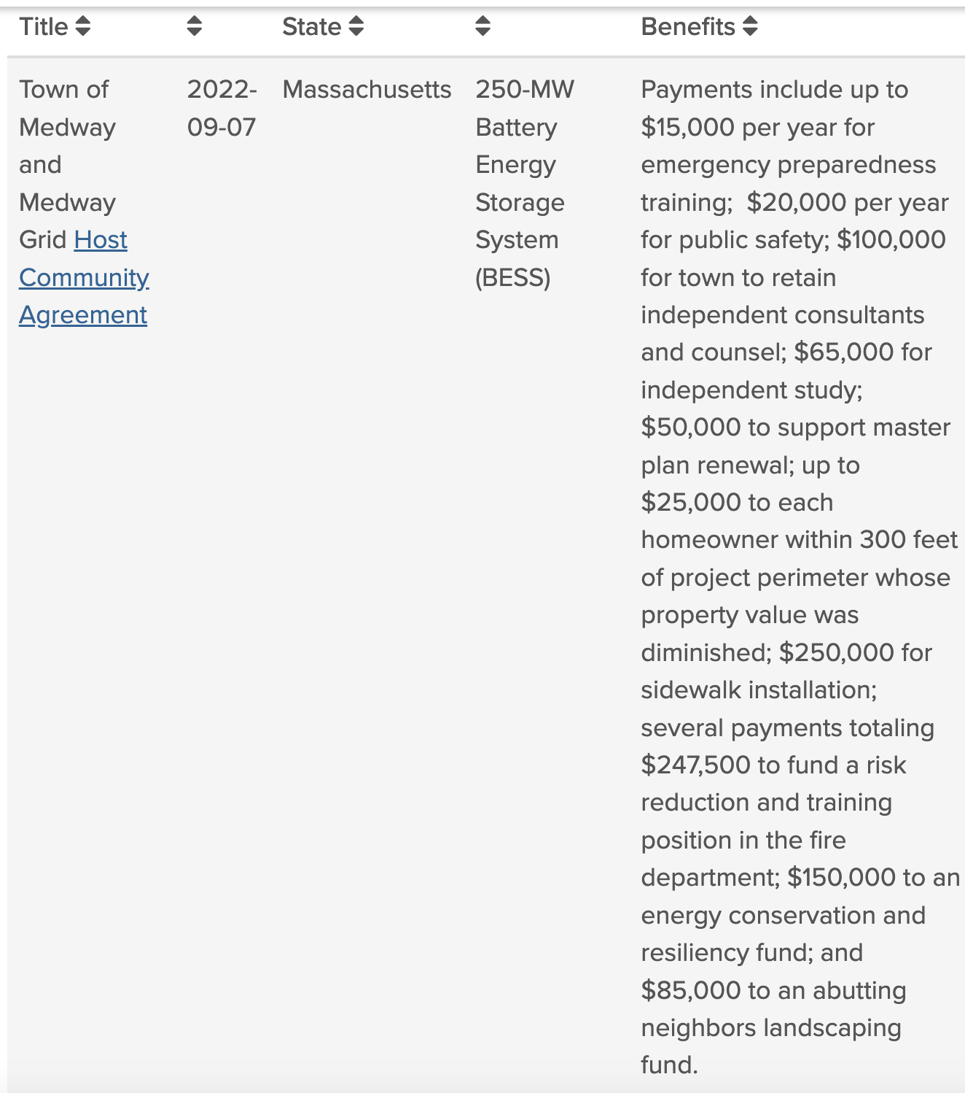
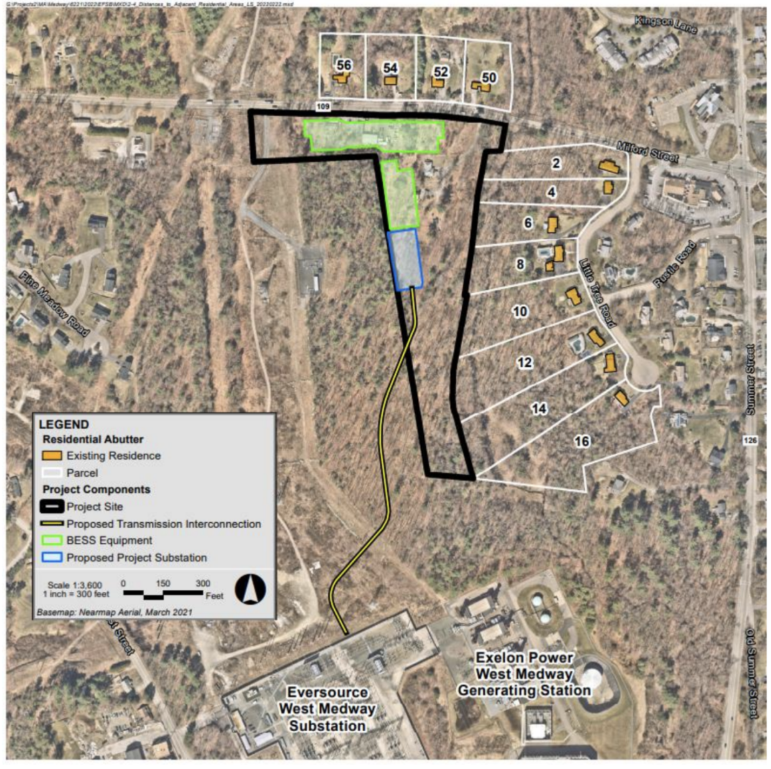
Medway BESS (2022)

Slide 9
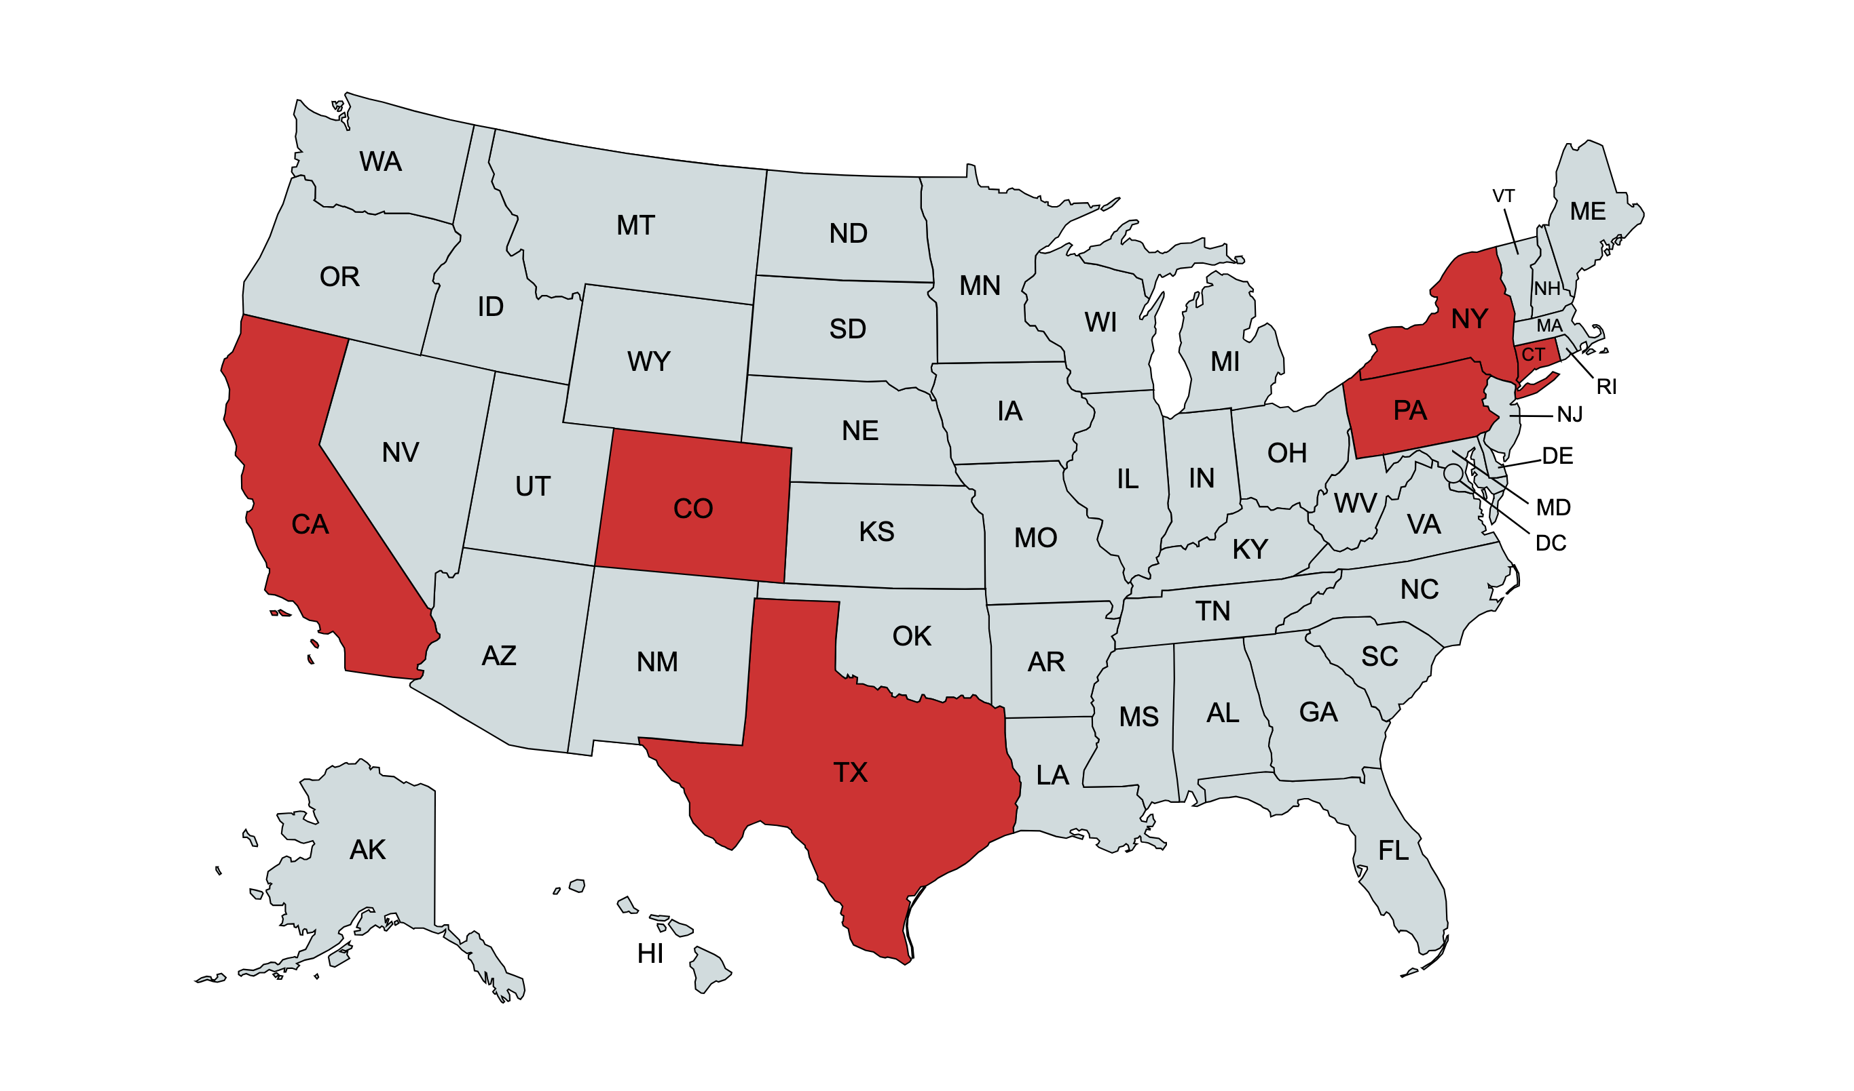
Experts Interviewed by Sabin Center
Notes:
Professional qualifications: 9 lawyers, 2 non-lawyers
Experience: 6 developer side (incl. 4 outside counsel, 6 community side (incl. 4 outside counsel), 1 mediator

Slide 10
Best Practices for Developers (Partial List)
#1 Hire local outreach firm
#2 Start with conversations not deals
#4 Engage with local officials early and often
#6 Meet one-on-one with neighbors
#8 Take community members and local government officials on tours of comparable facilities
#15 Get all terms finalized before agreeing on amount of payment

Slide 11
Best Practices for Host Communities (Partial List)
#1 Speak among yourselves before speaking with developer
#4 Ask developer for information about its other facilities and affiliates
#5 Ask developer for all information about the site
#6 Hire technical expert – and ask developer to pay for it
#7 Hire counsel

Slide 12
Best Practices for Drafting (Partial List)
#1 Tailor benefits to community needs and priorities
#2 Avoid ambiguity
#3 Tie benefits to the tax burden of the project
#4 Set end date to any benefits and obligations
#5 Mandate schedule for application review
#6 Include provisions for amendment and renewal
#7 Include mechanisms for monitoring compliance and enforcement
#8 Include provisions for monitoring environmental hazards

Slide 13
Who are the parties to the agreement?
Remember the principle of “privity of contract” – only parties to an agreement are bound by, and can enforce, its terms (with limited exceptions)
Agreement should bind the developer and its successors and assigns

Slide 14
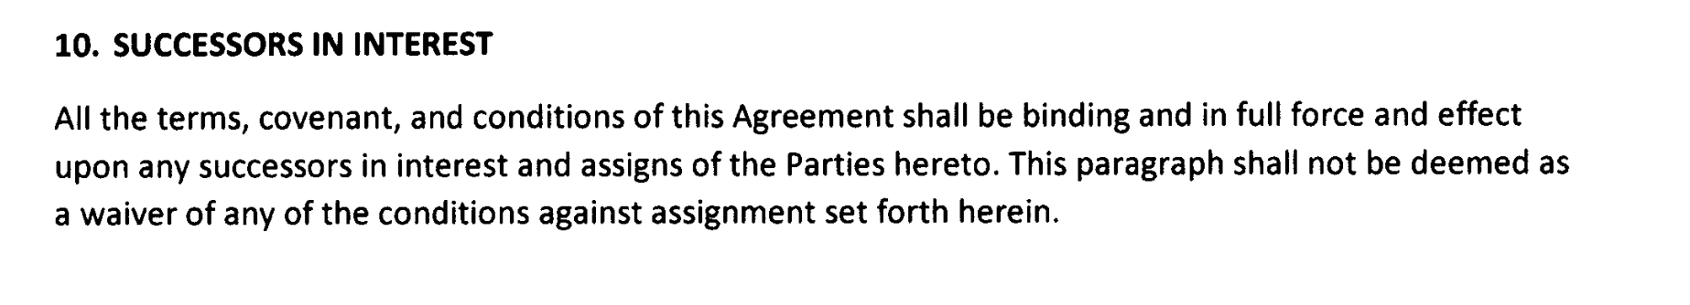
Ensure the CBA “runs with” the project

Slide 15
Special considerations for CBAs involving local government entities
Exaction = a condition that a local government imposes on a developer in return for the local government agreeing to allow a land use that it otherwise could prohibit.
Exactions must meet (at least) two requirements:
  Nexus Requirement: The benefit exacted from the developer must have an “essential nexus” to the legitimate state interest that the local government would have invoked to prohibit the development.
  Proportionality Requirement: The benefit must be
  roughly proportional to the impact the development would
  impose.

Slide 16
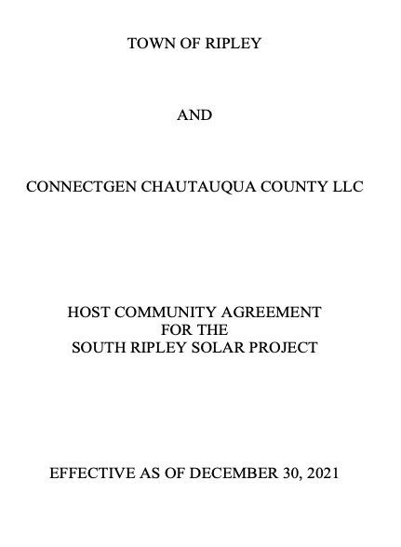

South Ripley Solar Project
270 MW solar + storage project covering approx. 1,500 acres

Slide 17
“The Company shall annually make Host Community Benefit Payments in the amount of $1,750 per MW[] of installed solar” capacity.
“Host Community Benefit Payments shall be increased during the Term by two percent (2.0%) over the previous year.”
“Any Host Community Benefit Payment not received as of the date due shall be deemed late without any requirement of notice from the Town. Late fees shall be assessed at a rate of one percent (1%) for each month or a portion of a month that the original amount outstanding remains due.”
“Host Community Benefit Payments made . . . hereunder may be used by the Town for any lawful public purpose, which purposes shall be determined in the sole and absolute discretion of the Town."

Slide 18
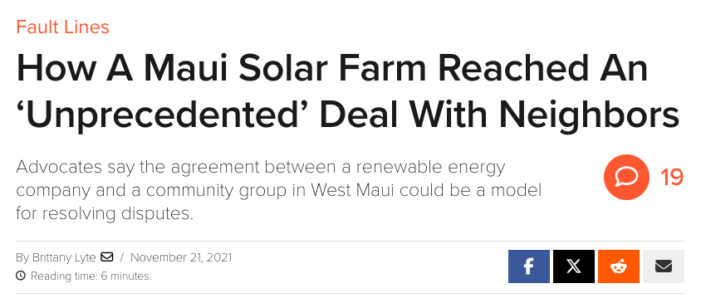

Community Benefits Package -- “Funding from Kahana Solar will be a fixed commitment of . . . $1,375,000, which breaks down to $55,000 per year of Project commercial operation for 25 years. The $55,000 will be broken down into an annual $40,000 allocation . . . and an annual $15,000 allocation”

Slide 19
$40,000
To be “allocated at the discretion of Kahana Solar, consistent with its corporate vision, values, policies, and sustainability requirements”
$15,000
To be used by the Hawaii Community Foundation to issue grants “at its sole discretion” provided that the grants “align with Kahana Solar’s corporate vision, [and] values”

