Slide 1


Solar and the environment
Annick Anctil
Associate Professor Civil & Environmental Engineering & AgBio Research
Associate Director Michigan Industrial Assessment Center
anctilan@msu.edu

Slide 2

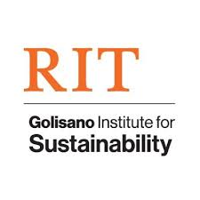










About me…
BE & MS in Materials Engineering
  MS on Nanomaterials for Organic PV
    Carbon nanotubes / Fullerenes / Organic Dyes
PhD Sustainability
  Fabrication and life cycle
  assessment of organic photovoltaic
Post-doc
Faculty
Other Things I do
Organize conference/ sustainability standards/outreach events / international projects / Michigan Energy Research.
2014

Slide 3
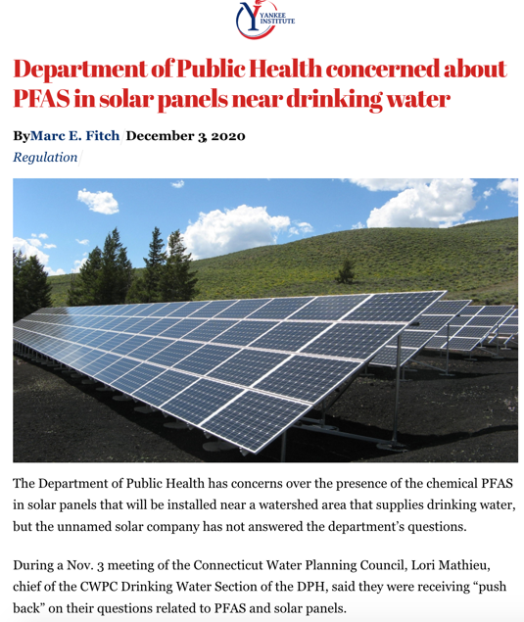
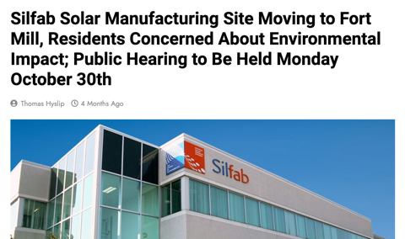
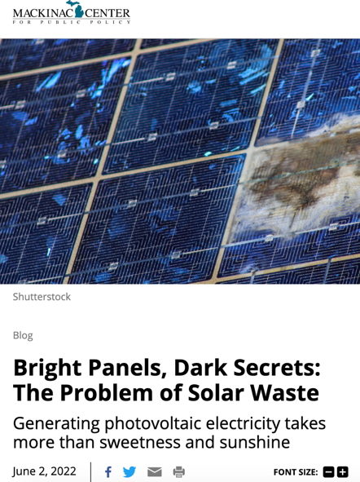
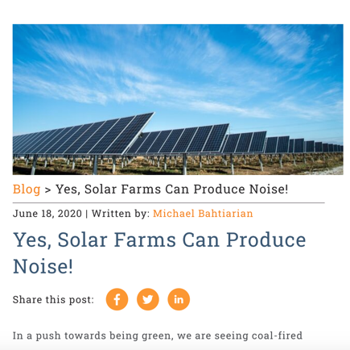
Addressing general public concerns

Slide 4
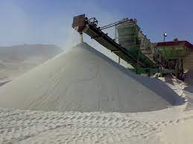
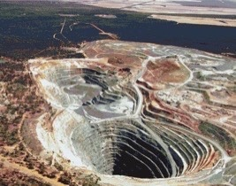
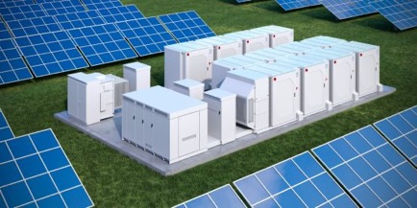
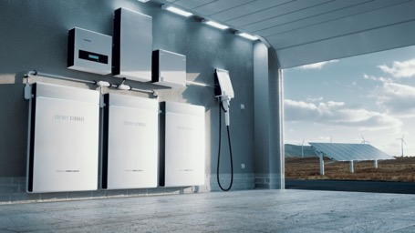
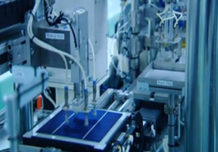
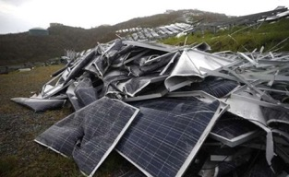

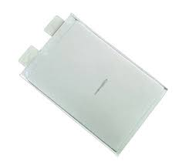
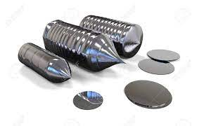



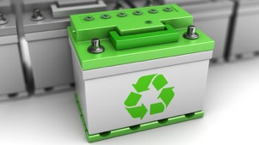
Life Cycle Assessment of Energy Systems
Mining
Coal
Natural gas
Nuclear
Manufacturing / Assembly
Renewable
Material Processing
Use Phase
End-of-life
Prospective LCA: evaluate new technology to reduce unintended consequences

Slide 5
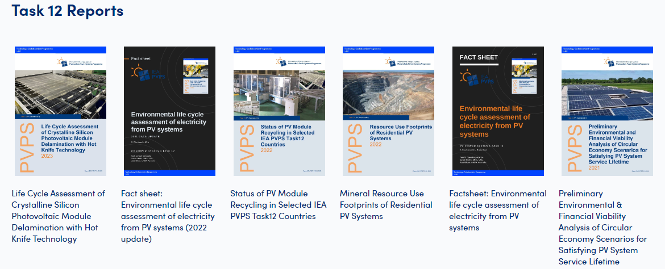
EOL concerns are new to the US – lot of international knowledge on the subject
Source: https://iea-pvps.org/research-tasks/pv-sustainability/

Slide 6

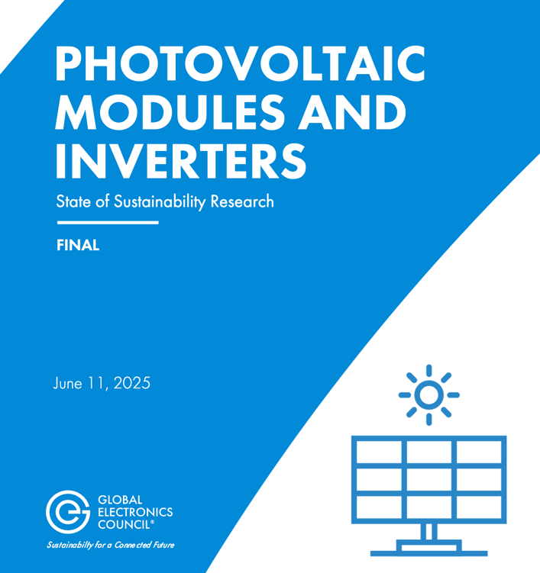
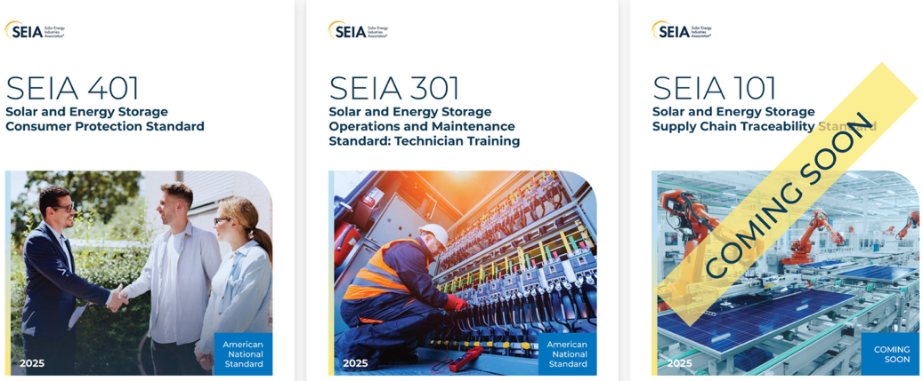
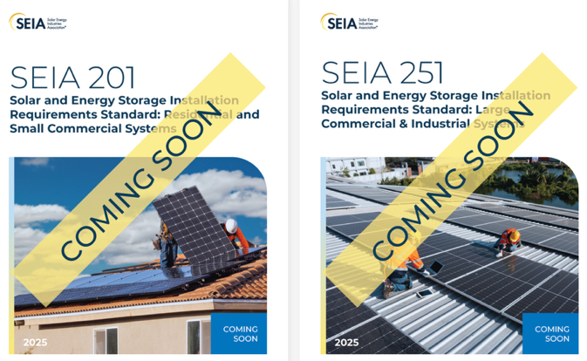
Ongoing standards efforts
Solar PV Modules – Sustainability Leadership being updated
https://globalelectronicscouncil.org/wp-content/uploads/PVMI-SOSR-FINAL_11June2025-1.pdf
https://standards.seia.org/

Slide 7
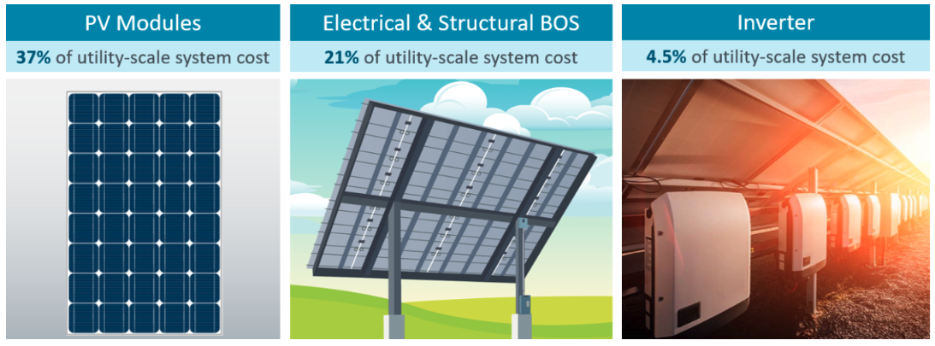
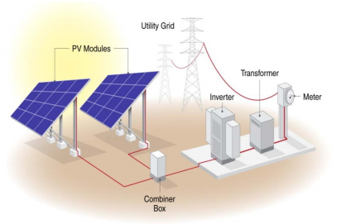
PV system BOS components concerns
Common concerns:
  Modules: toxicity
  Inverter/transformer: noise
  BOS: toxicity (cables + support system if galvanized steel)
  System: aesthetic

Slide 8
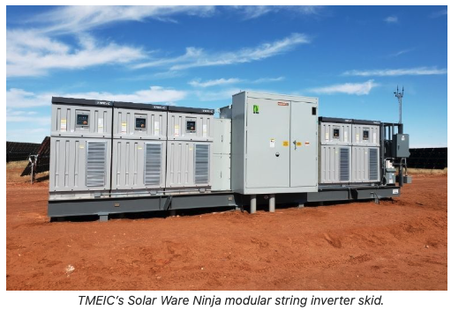
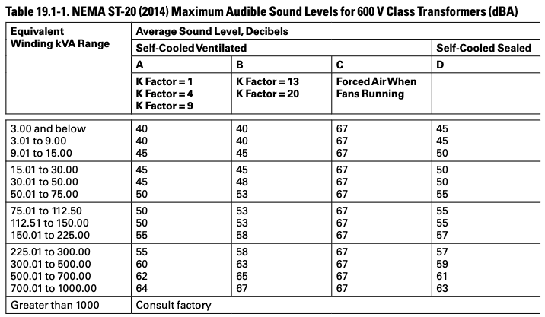
Noise - inverter
NEMA ST -20 provides noise standard
  Higher kVA ratings produce more noise
  Noise can be from fans + high-frequency circuits (whine)
  Maintenance reduces noise (if a broken/loose part)
Ultra-low-noise transformers exist
Noise can also be reduced by installation practice (sound-dampening pads, careful placement, sound barrier (plants) )
1: inverter https://www.solarpowerworldonline.com/2021/08/efficiencies-utility-scale-solar-inverter-design-developer-options/
2: Sound level for inverter: https://www.eaton.com/content/dam/eaton/products/design-guides---consultant-audience/eaton-dtdt-general-purpose-design-guide-ca009001en.pdf

Slide 9
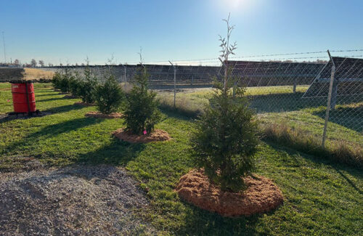
Solar screening
Aesthetic
Environmental benefits (additional carbon sequestration+ biodiversity + soil health / erosion control)
Be careful:
Single species use on all solar sites (fraser fir and other Christmas tree)
Non-native plants
Plants that would attract unwanted wildlife (deer) and wouldn’t last
Single species: diverse mix of trees, shrubs, plants, etc.
https://www.solarpowerworldonline.com/2025/03/effective-landscape-screening-can-enhance-solar-site-aesthetics/

Slide 10
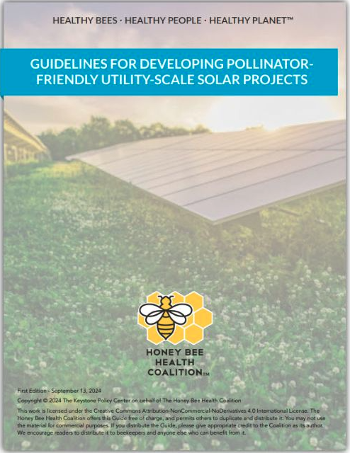

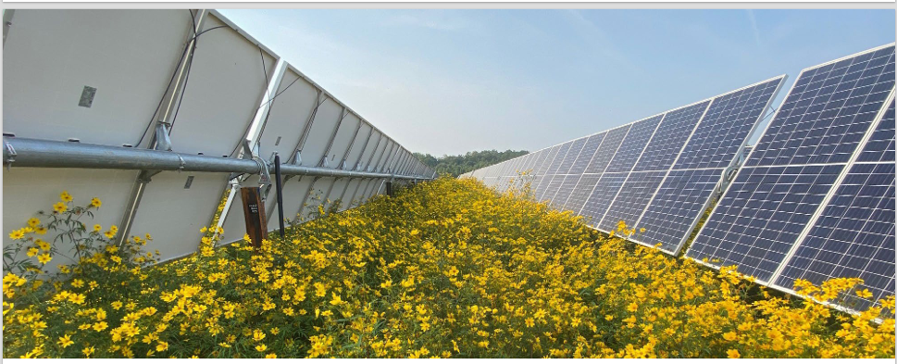
Pollinator Friendly Habitats
Benefits:
Increased pollinator health and habitat
Increased domestic honey production
Increased carbon sequestration
Reduced Stormwater Runoff
Challenges:
Lower panel height (needs do to be < 18” vegetation)
Water availability
Management and maintenance
NY: Pollinator-Friendly Solar Bill
https://www.canr.msu.edu/news/honey-bee-health-coalition-releases-pollinator-solar-guide

Slide 11
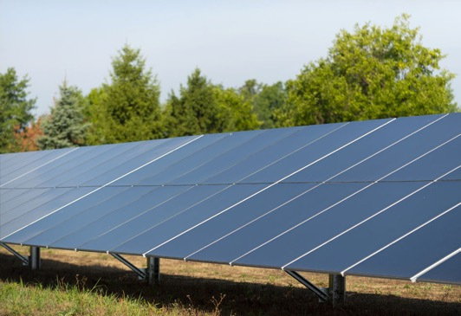

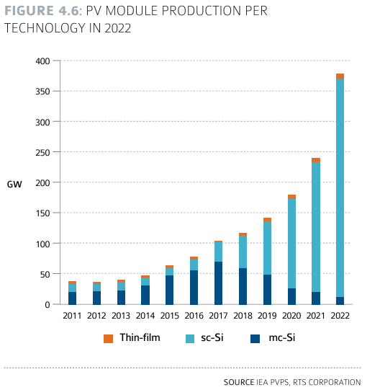
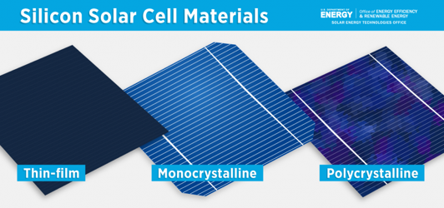
PV module types over time
https://www.energy.gov/eere/solar/solar-photovoltaic-cell-basics

Slide 12
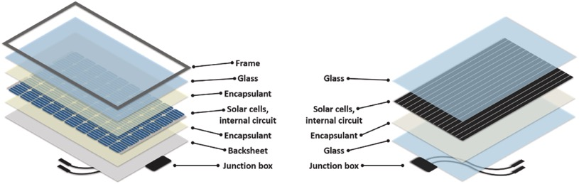
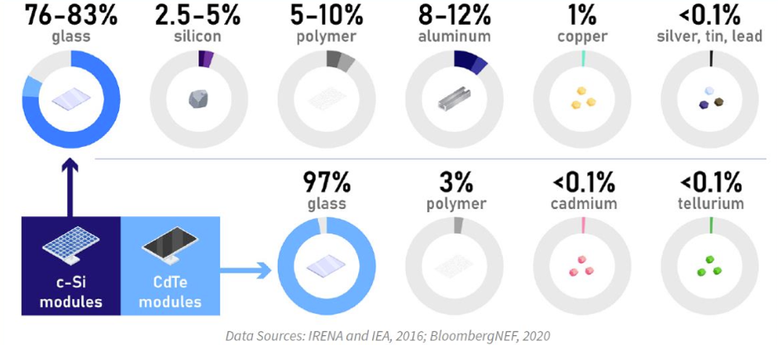
How do Si and CdTe modules compare?
Silicon
CdTe
Aghaei, M., et al. "Renewable and Sustainable Energy Reviews 159 (2022) 112160

Slide 13
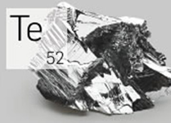
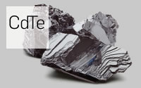
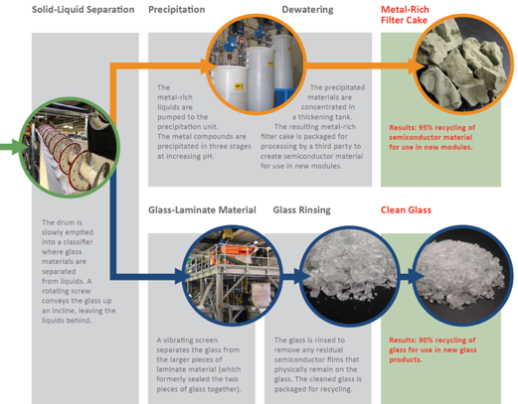
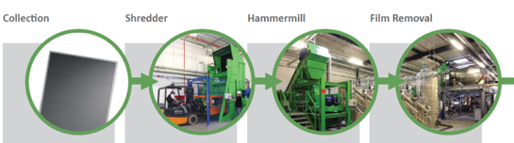
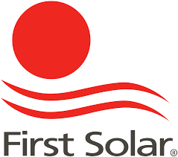
CdTe and recycling
Because tellurium is scarce and cadmium toxic – First Solar developed a recycling process from the start
All manufacturing locations have on-site recycling
Scarcity
Toxicity
90% of material is returned in new PV panels

Slide 14




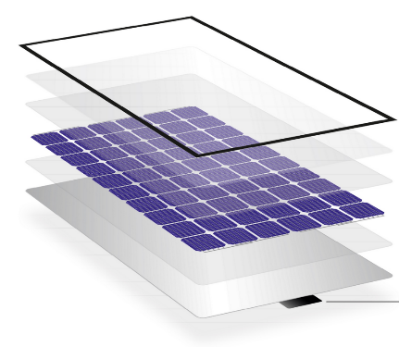

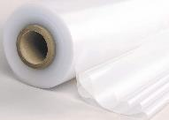
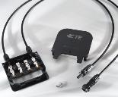
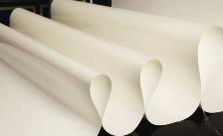

What is in a silicon solar module?
Solar glass
Glass
(76-83%)
Sb
Al Frame
AlMg₃ (8-12%)
Cell & String Ribbons
Cu (1 %)
Sn / Pb / Ag (0.09%)
Solar Cells
Si (2.5-5%)
Ag/PbO (0.04%)
Ag/Al/PbO (0.01%)
Al (0.07%)
Ethylvinylacetate
(6.7%)
Junction Box
GfK, Polyamid (1.6%) Silicone (1.2%)
Diode/Cable (0.02%)
11.6 kg/m²
Back sheet
Polyvinyl fluoride (PVF)/adhesive /PET(3.7%)
Fluorine

Slide 15
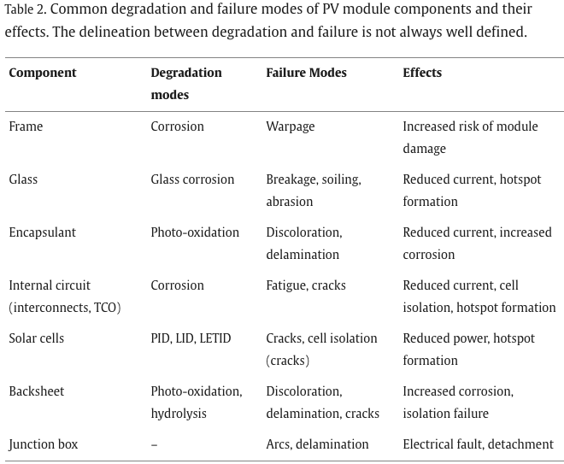
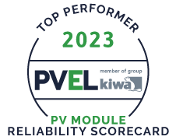

Why solar modules reach end-of-life?
Degradation
  Warranty 25-30 yrs
  Vary with environmental stresses
    Irradiance
    Temperature
    Moisture
    Mechanical Load (wind/hail/snow)
    Soiling
    Chemicals
2. Failure
  Module design
  Defects
3. Economic reasons (repowering)
Modules have become cheaper by reducing the amount of material (reduce recyclability)
Higher efficiency modules at lower cost increases early replacement
Good candidates for reuse/repowering

Slide 16
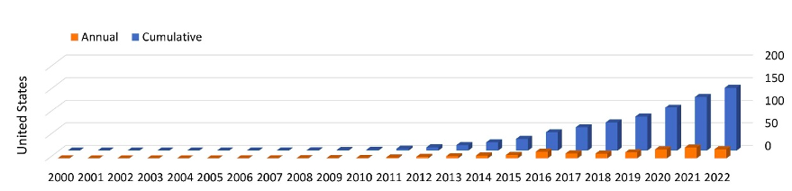
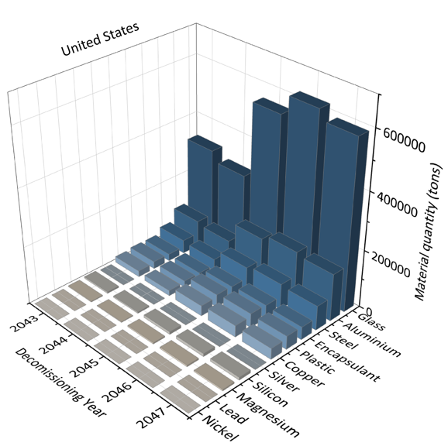
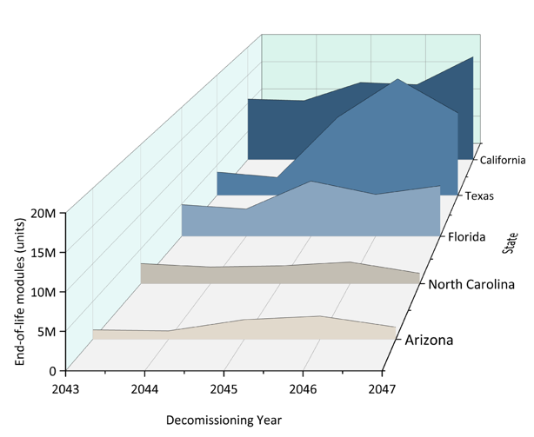
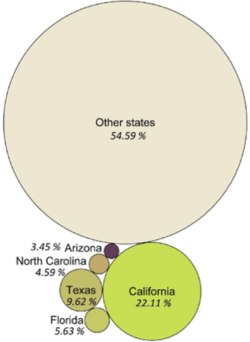
PV waste in the US
Almost all the mass of waste is glass + aluminum + steel
PV installation (GW)
Ref: Nain, P., & Anctil, A., (2024). Resources, Conservation & Recycling Advances journal

Slide 17
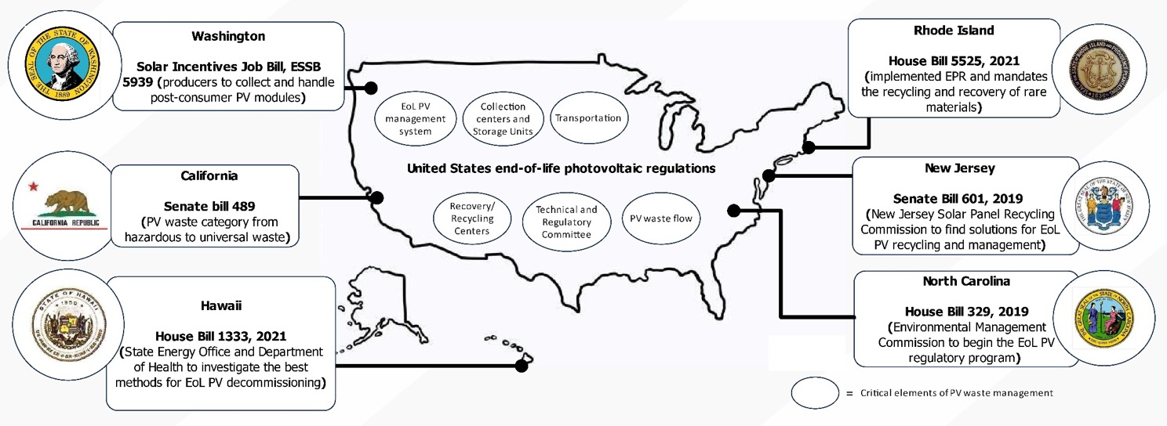
PV waste regulations in the US
No federal regulations – other states are considering regulations
Ref: Nain, P., & Anctil, A., (2024). Resources, Conservation & Recycling Advances journal

Slide 18

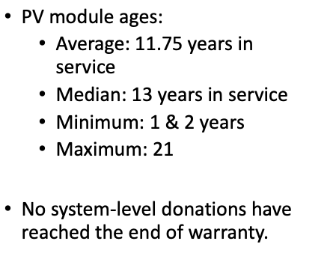
Company working on 2nd life PV
Started in 2019 in Colorado – now operate also in New Mexico
Focus on reusing solar PV equipment to create the greatest value for those in our communities with the greatest need
Tier 1 – meets datasheet and no defects or other issues preventing 20 years of future performance. Unrestricted use.
Tier 2 – meets datasheet but defects or other factors reduce likelihood of 20 more years of operation. Restrict use to systems operated, maintained and monitored by ESS on a daily basis.
Dispose/Recycle – does not meet datasheet and/or safety issue with the module.
Extensive on-site testing before module removal – current PV installers not trained for EOL inspections
Not for profit
Rich Stromberg - NREL circularity workshop 2024

Slide 19
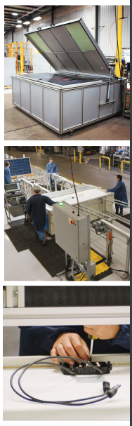
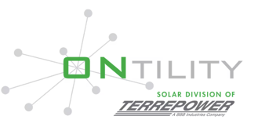
Sparta TN facility
Background from repurposing/repair in car industry – following the same model for PV
Sell 2nd life PV
Replaced large sites from monofacial to bifacial (250-300 MW)
Insurance claims: truck incidents or undamaged solar panels after a storm
Recycling – started in 2024
Services /repairs: J-box, cables, connector repair or replacement, backsheets repair
Off-site facility for testing and repairs of modules
The cost of new PV is so low – difficult to compete with 2nd life modules

Slide 20
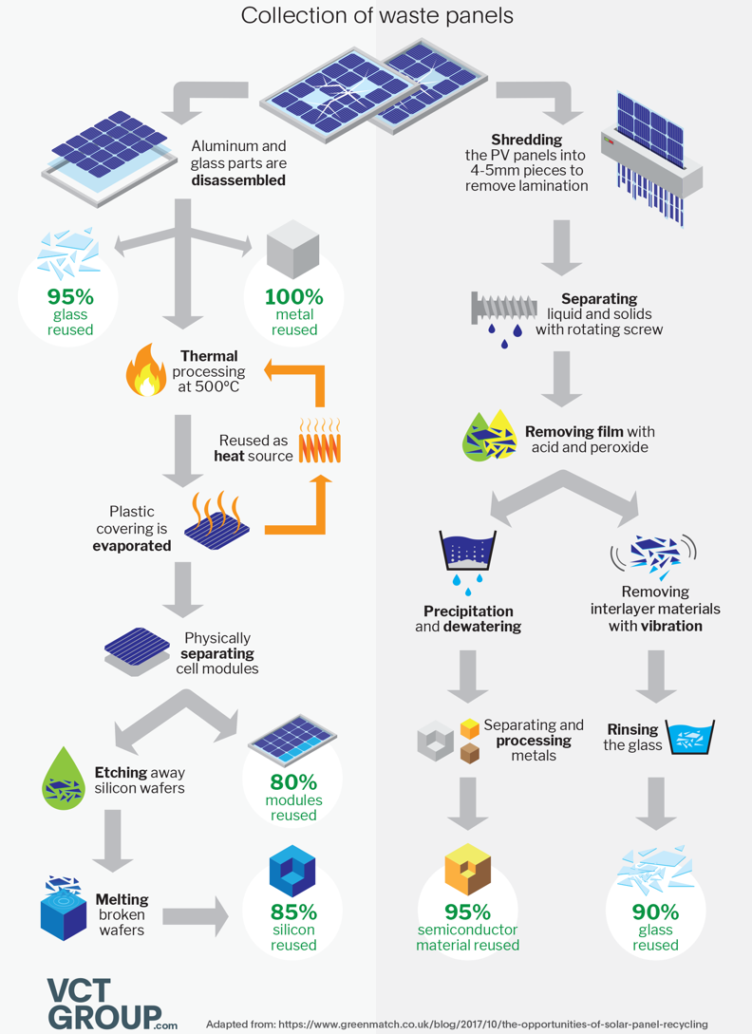



Recycling processes
Approximately 15 (recent estimates say 30% now) of modules are recycled in the U.S.
Inconsistencies between local, state, and federal regulations
High complexity of procedures
Recycling is $15-45 per module to recycle vs less than $1 to landfill
# Recyclers is increasing rapidly in the US
Recycling partners

Slide 21


Purity of recovered materials matters – difficult to return silicon and glass to solar PV manufacturing so it is generally downcycled
The facility will use recycled materials from retired solar panels to make new solar glass in what Solarcycle said was a “first-of-its-kind” endeavour in the US.

Slide 22

Progress in PV recycling

Slide 23



How can we get encourage PV 2nd life/recycling?
Encourage products certification – support for recycled content
EPEAT Ecolabel
Solar waste policy (state + federal)
Increase the cost of landfilling
Decrease recycling costs (invest in research/ recycling industry) – create a new industry for PV

Slide 24

PV compared to other type of wastes
Global cumulative wastes from 2016 to 2050
The toxicity of PV module waste is also much lower than both coal ash and oily sludge from crude oil production.
Treating decommissioned PV modules as a commodity and opportunity for material recovery, and not as hazardous waste would be environmentally and economically beneficial.
Mirletz et al. (2023). Nature Physics Journal.

Slide 25

PV module toxicity testing
If module fail the TCLP – it is considered hazardous waste
Very sensitive to sample preparation and testing conditions
TCLP is required in most states for PV recycling

Slide 26


Slide 27


Toxicity of PV and other wastes
Leaching and
ICP-MS characterization (TCLP – WET )
Digestion: total metal content
If PV panels pass TCLP test, are they safe for disposal?
Batch test with simulated landfill conditions, with and without municipal solid waste (MSW)

Slide 28

TCLP test results (EPA Landfill test)
Many common electronic products would be considered hazardous waste
Kilgo, M. Anctil A (2022). Chemical Engineering Journal, 431, 133825.

Slide 29

Most comprehensive TCLP testing
Some modules have low amount of lead – most don’t
Older modules are most likely to have lead
Manufacturers should have to disclose toxic chemicals

Slide 30




Anctil group ongoing research on PV toxicity
Metals and PFAS analysis
ICP-MS analysis for metal content

Slide 31



PFAS
Per/Poly Fluoro-Alkyl Substances (PFAS) are a class of chemical compounds typically made of a chain of carbon atoms surrounded almost entirely by fluorine atoms.
PFAS are used in several industries because they create coatings that are extremely water repellent.
States with most contamination: North Carolina and Michigan
https://riversideca.gov/press/understanding-pfas
Added to EPA TRI in 2020

Slide 32


PFAS in solar
information regarding PFAS types, amounts, layer thickness, and host component characteristics is lacking.
While some laboratory studies explore hydrophobic PFAS coatings, they appear absent from commercial solar modules.
Most PFAS used in solar modules are fluoropolymers, considered a low-risk PFAS subgroup.

Slide 33


PFAS
Currently, no standardized methods exist for PFAS analysis in electronics.
Point-based health risk assessment in this work indicates no risk for PFOA, PFNA, PFOS, PFBS, or GenX for solar modules.
Advancing quantification techniques for PFAS in solid matrices could enhance analysis capabilities and inform waste characterization strategies for the emerging solar waste stream.
SL: Screening level HQ: hazard quotient

Slide 34

Recycle rather than address toxicity concerns!
Recycling solar panels rather than landfilling is the best way to reduce the risk of material release.
Reusing degraded but still functional panels is a better option.
By 2050, the value of raw materials recoverable from solar panels is expected to exceed $15 billion.
Source: Article by Jon Hurdle, Yale Environment 360, February, 2023

Slide 35
Conclusion
Sustainable PV must consider all stages of solar from design to end of life
  Reduce full life cycle impact is required from design phase
  2nd life PV is emerging in the US and recycling is improving rapidly, and can recover most of the PV material and return it to make new PV
  Risk of toxicity is very low, in particular from modules

Slide 36

Thank you!
anctilan@msu.edu

