Slide 1
Clean Energy Projects
Land Use System and Community Engagement
Jessica A. Bacher, Esq.
Executive Director, Land Use Law Center
Elisabeth Haub School of Law
Pace University

Slide 2
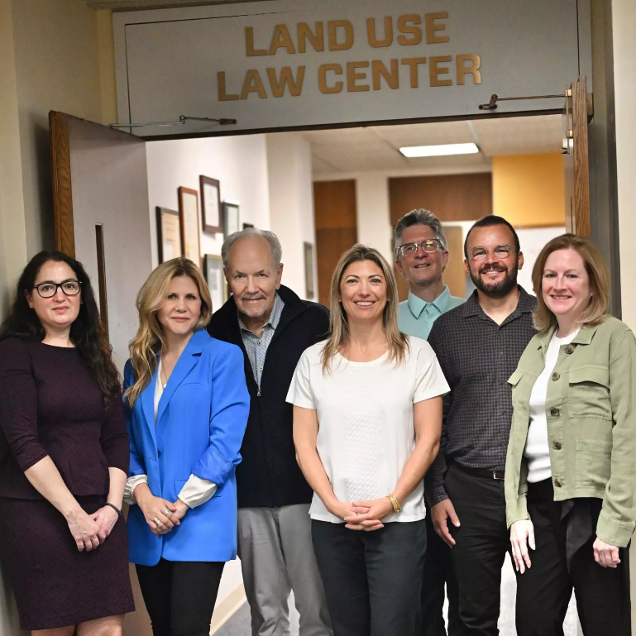
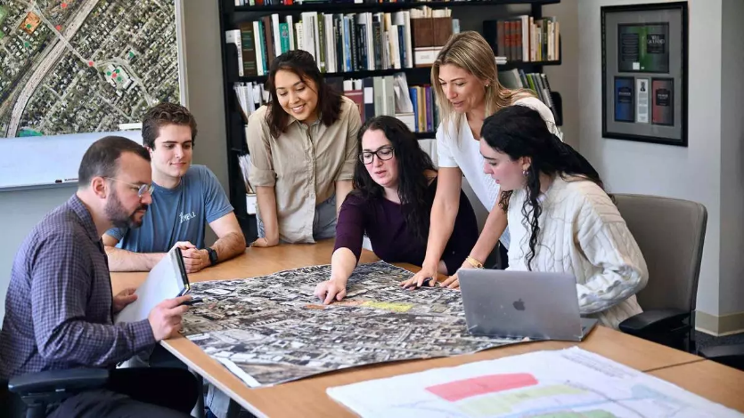
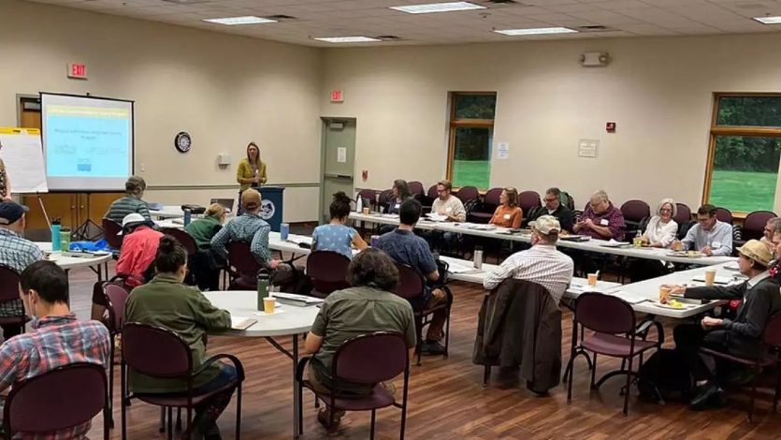
Land Use Law Center
Dedicated to fostering the development of sustainable communities through the promotion of innovative land use strategies and collaborative decision-making techniques.

Slide 3


Land Use Leadership Alliance Training Program
Educating local land use decision-makers on legal tools and techniques and collaborative decision-making to address complex land use issues
Recruitment Process - selected individuals to participate in program
Three days of training
Based on the theory of the “diffusion of innovation”
Responds to the direct needs of the participants
Notes:
Many know us for our award winning LULA program. A four day training program in which local leaders are nominated to attend and spend time together discussing land use and collaborative decision-making. Participants range from local land use board members to developers, citizens, planners, staff, etc. We bring a diverse group of 35-40 people together, all with a variety of perspectives and thoughts regarding land use and spend time talking about roles, responsibilities, authority, tools and techniques and most importantly innovation and best practices from across the region and in their backyard.

Slide 4
The Process of Innovation “Diffusion”
“Most individuals evaluate an innovation, not on the basis of scientific research by experts, but through the subjective evaluations of near-peers who have adopted the innovation. These near-peers thus serve as social models, whose innovation behavior tends to be imitated by others in their system.”

Slide 5

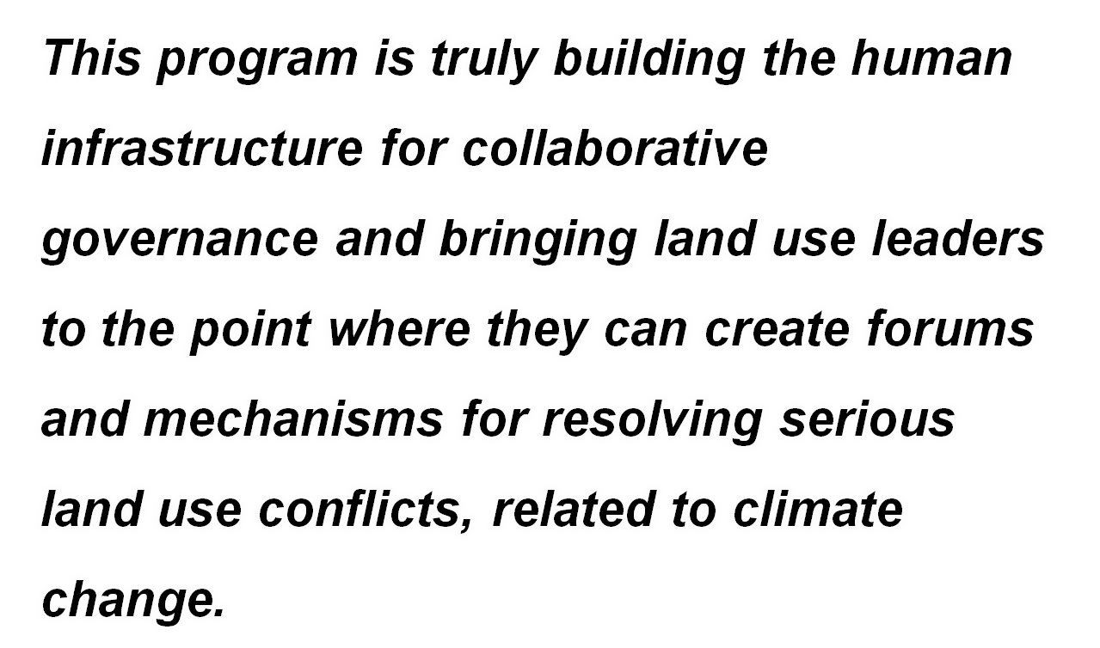
Photo: http://www.americanforests.org/planttrees/af_info.php?campaign=newframework

Slide 6
Delegation of Legislative Authority
The State Legislature
Town/ Village Board
Local
Boards

Slide 7
The Land Use Legal Framework
The New York State land use enabling act delegates authority to LOCALITIES to:
Adopt comprehensive plans
Zone
Adopt subdivision and site plan regulations
Issue special use permits
Award variances

Slide 8
Role of Local Gov’t & Planning
$0.17
Per watt
Source: NREL
1,550+ local jurisdictions in NY
With land use authority
Notes:
Role of Local Government & Planning
There are 1550 local jurisdictions in NY with unique permitting requirements, making it difficult for installers to enter new markets.

Slide 9
Delegation of Authority
Legislature
Adopt Land Use Laws and Plans
Site Plan Approval
Subdivision Approvals
Special Permits
Building Inspector/Zoning Enforcement Office
Building permits
Zoning Determination
Zoning Board of Appeals
Variances
Interpretation
Special Permits
Planning Board
Advises on Zoning Adoption
Site Plan Approval
Subdivision Approvals
Special Permits
Notes:
Role of Local Government & Planning

Slide 10
Why a Community Needs A NEW PLAN
Serves as a guide to decision-making
Opportunity to identify community needs in the years ahead
Create an organized pathway to changes needed within the community
Opportunity for public input instead of ad hoc conversations

Slide 11

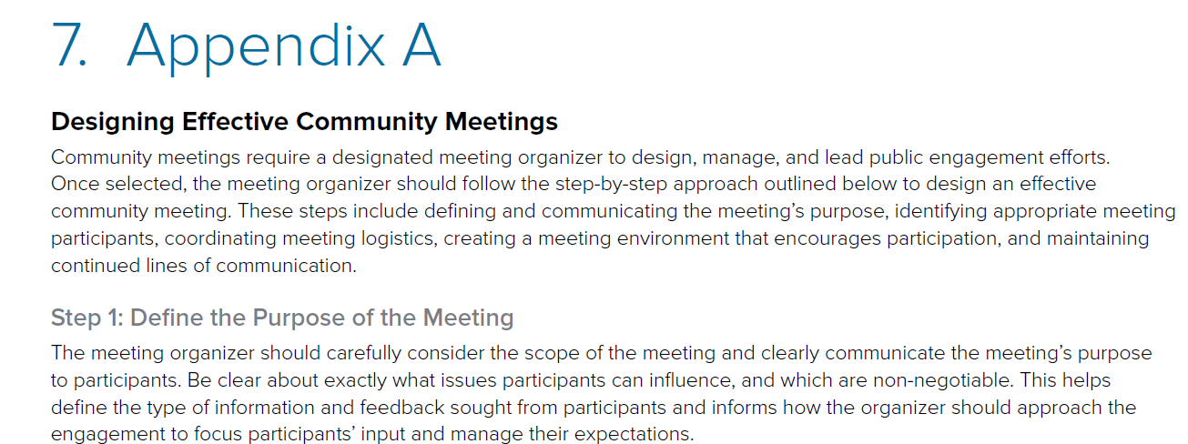
Clean Energy

Slide 12
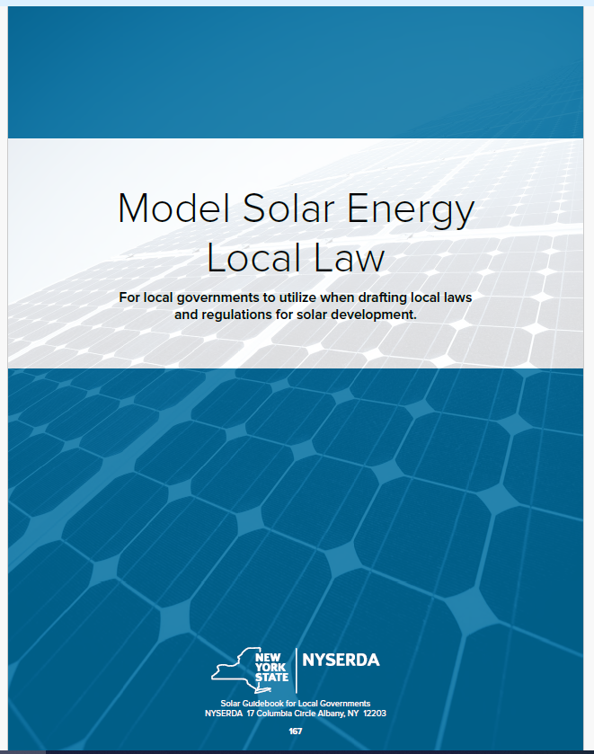
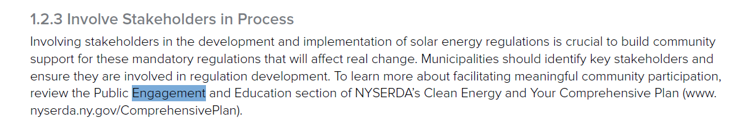

Slide 13
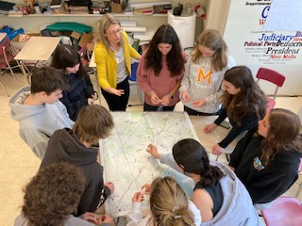

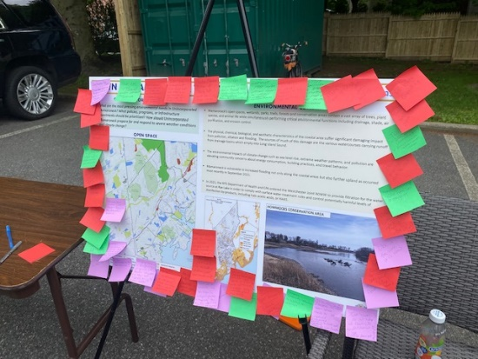
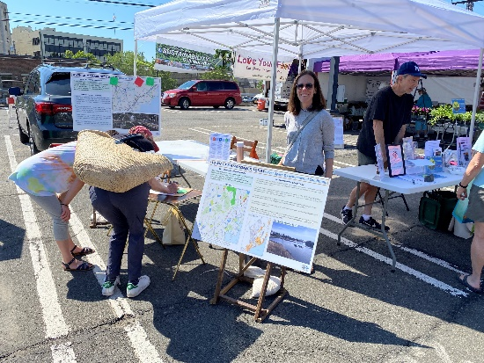
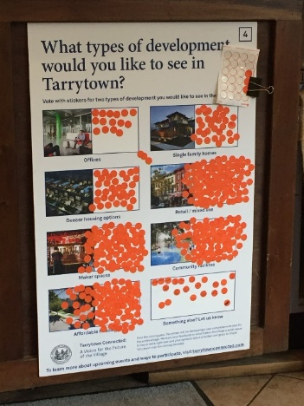

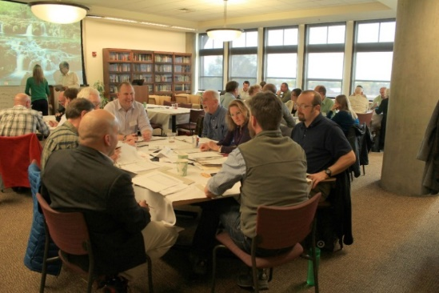
Public Engagement Efforts

Slide 14

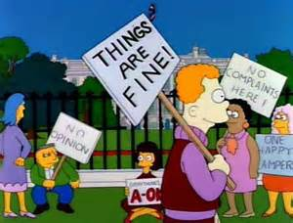
Imagine…

Slide 15
Stages of the
required decision making process for projects
1
Application Filed
2
Application Reviewed
3
Public Hearing
4
Decision Announced

Slide 16


Minimum or Maximize?

Slide 17
The Required Decision Making Process . . .
Doesn’t prevent or avoid challenges from being made by the public
Doesn’t help create conversation between local boards, developers and the affected public
Doesn’t reduce the possibility of opposition
Doesn’t get community support

Slide 18
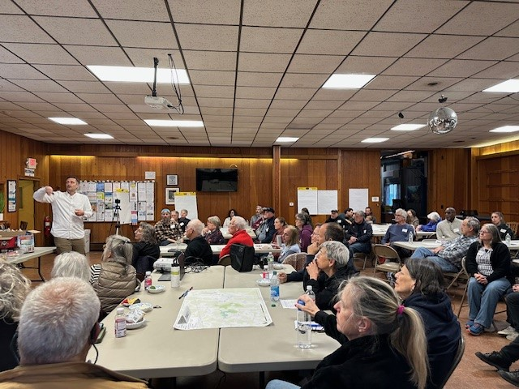
How do we get to a shared community vision?
Public engagement
The public is “engaged” when they play an effective role in decision-making and are actively involved in:
defining the issues
identifying solutions
developing goals
prioritizing strategies

Slide 19
How to Effectively engage the public
  Engage Early
  Listen & Learn First
  Be Inclusive & Involve Many
  Be Transparent & Responsive

Slide 20
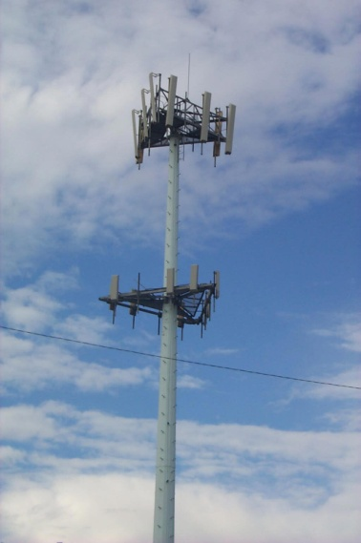



The Land Use Legal Framework . . .
Federal and New York State laws to preempt or limit local land use authority regarding issues, such as:
Major Renewal Energy Projects
  ORES PERMITTING
Cellular facilities
Religious uses
Group homes

Slide 21
Pre-Application
Update Comprehensive Plan
Inventory areas of cultural significant, natural and agricultural resources.
Adopt Specific Zoning Laws
Utilize NYSERDA Resources like Comprehensive Plan Guide and Model Solar Energy and Battery Energy Storage Systems Local Laws
Meet with Developer Early and Often
Statute requires only one meeting at least 60 days prior to application.
Engage Community and All Relevant Local Officials
Statute requires one meeting with neighbors. Help to identify community concerns early and potential community benefits for negotiating a Host Community Agreement.

Slide 22
Pre-Application (continued)
Negotiate Host Community Agreement
Residential customer from host municipalities are entitled to receive ten years of utility bill credits ($500/MW for solar & $1,000/MW for wind).
Agreement may include direct investment in municipal services, such as workforce development, and infrastructure improvements.
Negotiate PILOT Agreement
Payment in Lieu of Taxes - Predictable revenue stream, often structured over a 15–30-year term.
Establish a Comprehensive Public Engagement Process
Publicly accessible website and phone number.
Consider a dedicated liaison between community and developer.

Slide 23
Final Permit and Construction
Negotiate for Compliance Mechanisms and Expenses
Related to Host Community Agreement.
Request an Ongoing Developer Presence
Keep the community engaged and educated.
Allocate Funding for Post-Permit Activities.
Related to Intervenor Funding.

Slide 24
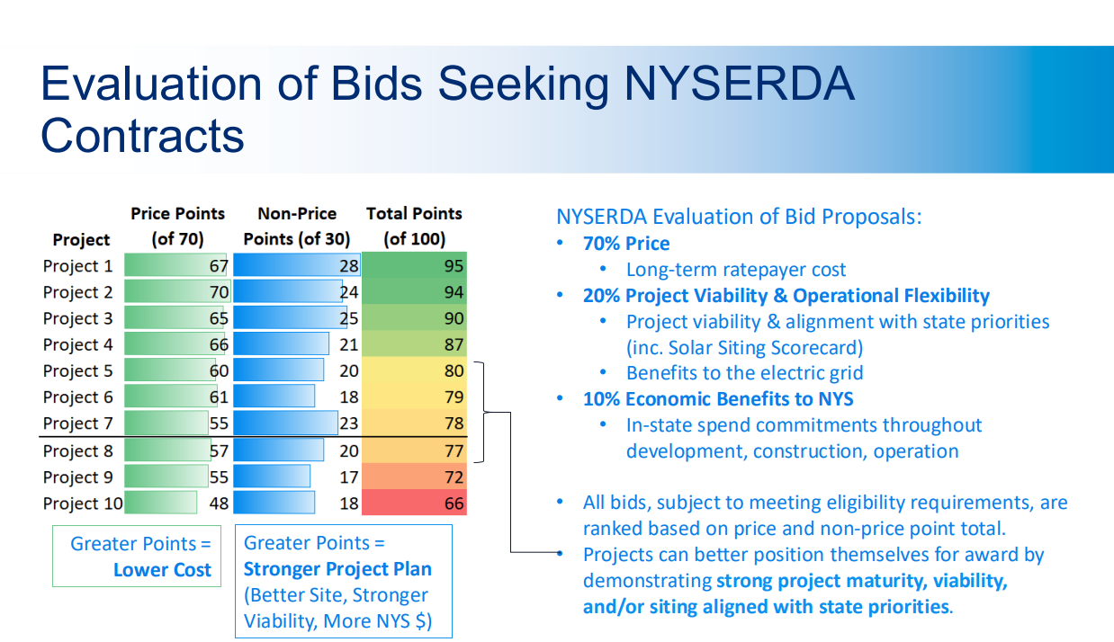
https://www.nyatwg.com/

Slide 25
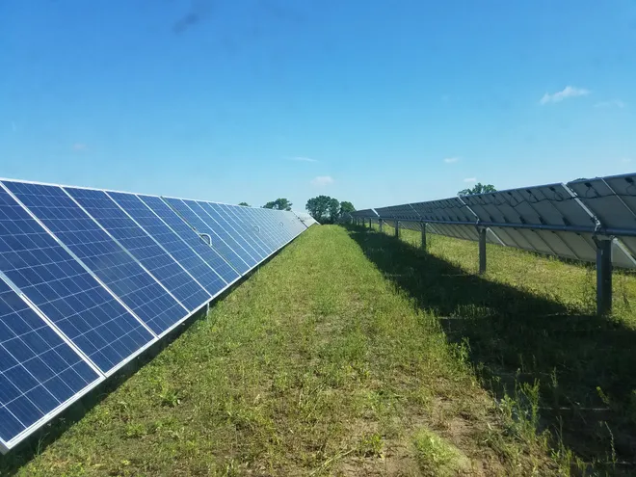

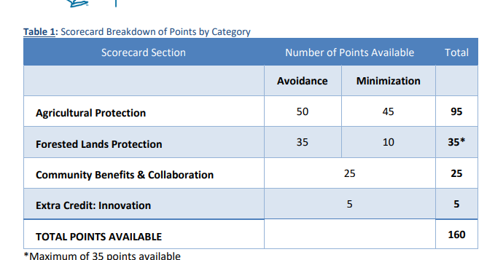
SMART SOLAR SITING SCORECARD
(evolves year to year)
https://www.nyatwg.com/

Slide 26
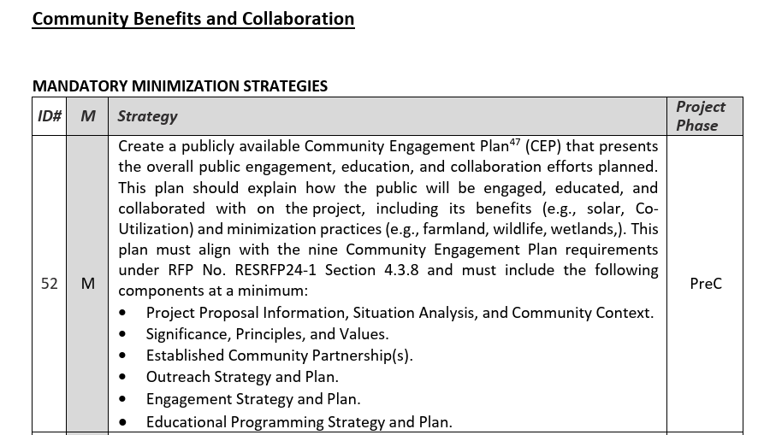

Slide 27
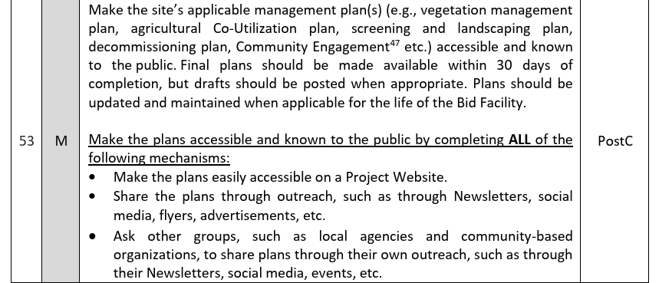

Slide 28
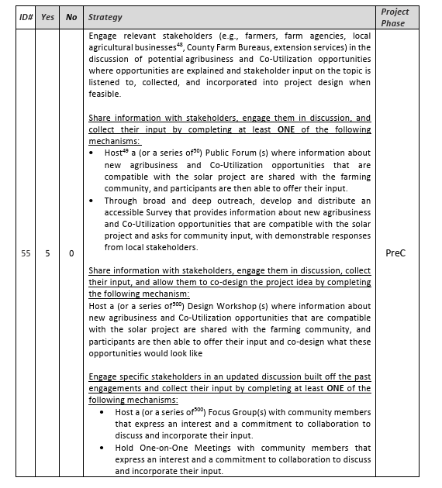

Slide 29
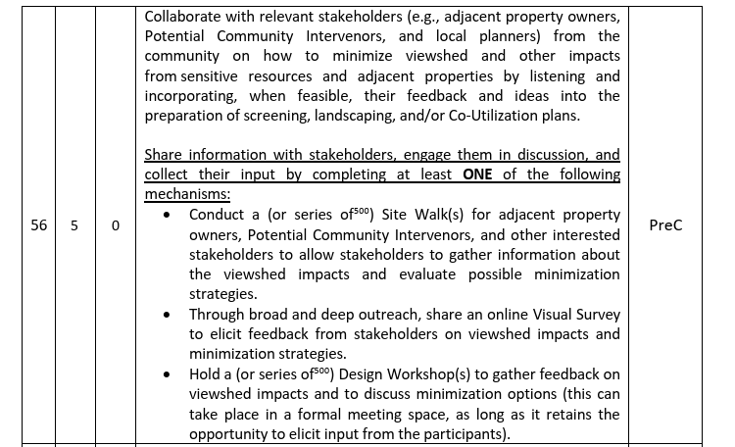

Slide 30
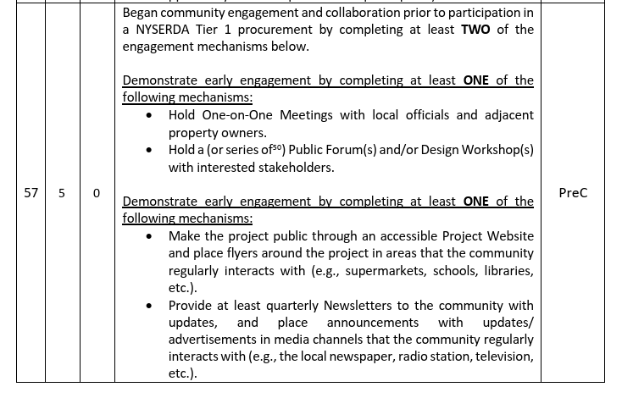

Slide 31
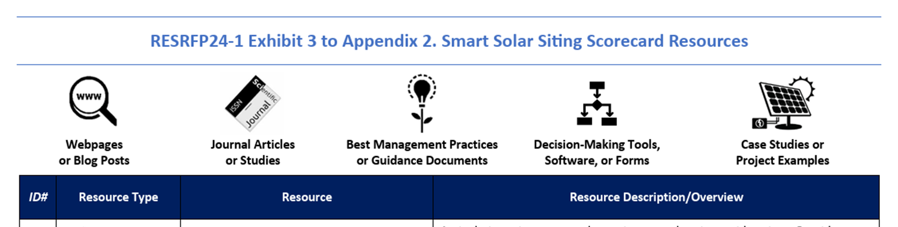
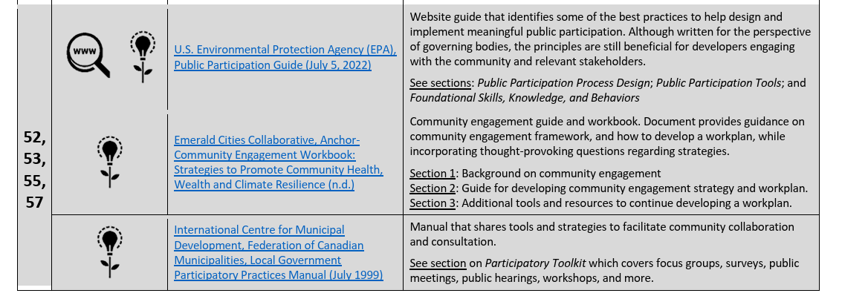
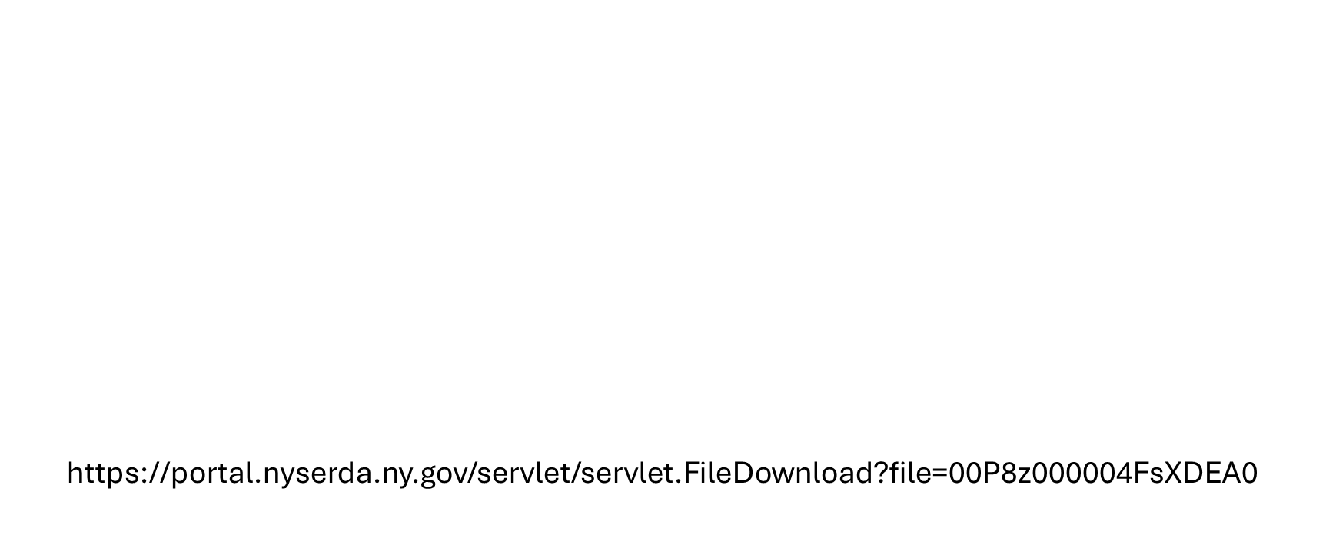

Slide 32
