Slide 1
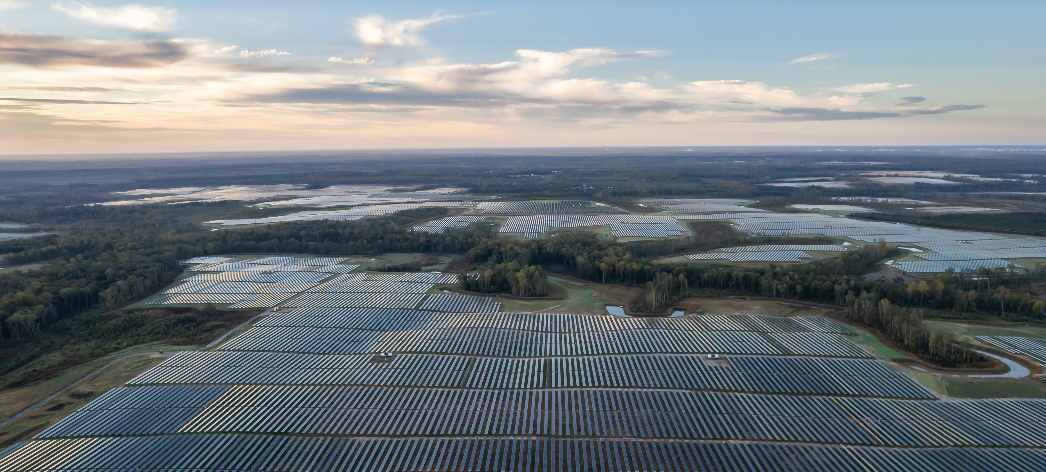
AES Renewable Energy Development and Stakeholder Engagement
Neely Kelley
Senior Manager, Stakeholder Relations
Rochester, NY

Slide 2
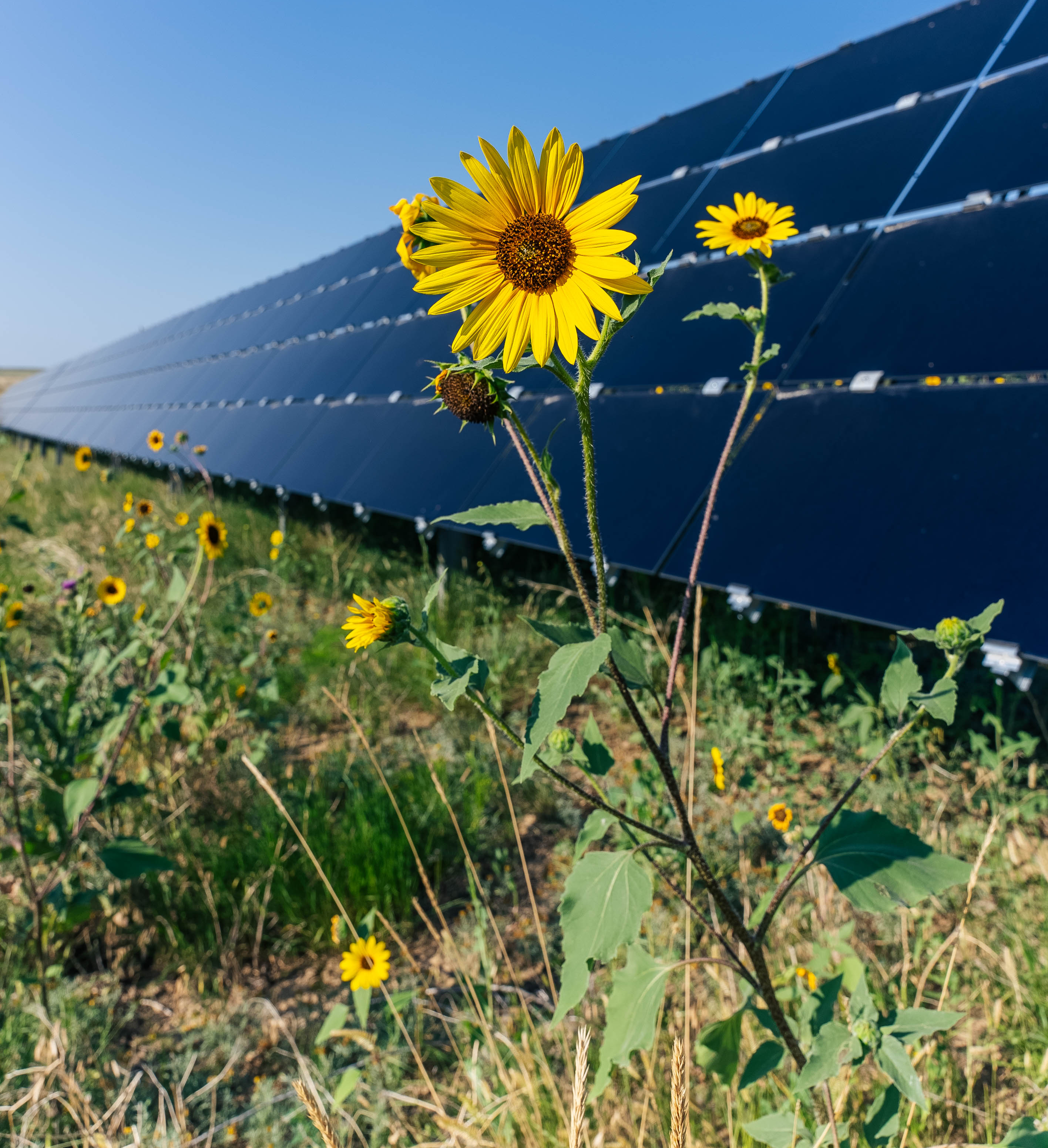
Presentation Outline
AES: An Overview
Stakeholder Relations Team
Article VIII permitting timeline and application process
Notes:
20 seconds
Over the next hour of so – here’s what we want to achieve.
We want to demystify what our team does and bring visibility to the value we can add to other teams across the organization
We also want this session to be future facing, we want this to spark great questions, but also future opportunities to work together.

Slide 3



AES Purpose & Values
Safety first
Accelerating the future of energy,
together
Highest standards
All together
Notes:
At AES, our purpose is to improve lives by delivering the smarter, greener energy solutions the world needs. Together, we are accelerating the future of energy.
AES’ team of innovators transformed us into the world’s most impactful energy company.
Our purpose is our foundation and unifies our people, wherever we work.
We believe that climate change is one of the most critical issues of our time.
The world needs drastic climate action to reach a net-zero future by 2050.
Our values in action
Safety first. Safety is at the core of everything we do. We always identify potential risks to our people, contractors, customers, partners and communities, and measure success by how safely we conduct our work together while contributing to a greener energy future.
Highest standards. We act with utmost integrity towards our people, contractors, customers, partners and communities, and hold the solutions we deliver together to global standards of excellence.
All together. We work as one team across our business and with our people, contractors, customers, partners and communities. We meet changing customer needs with agility and have fun solving meaningful challenges as a team.

Slide 4
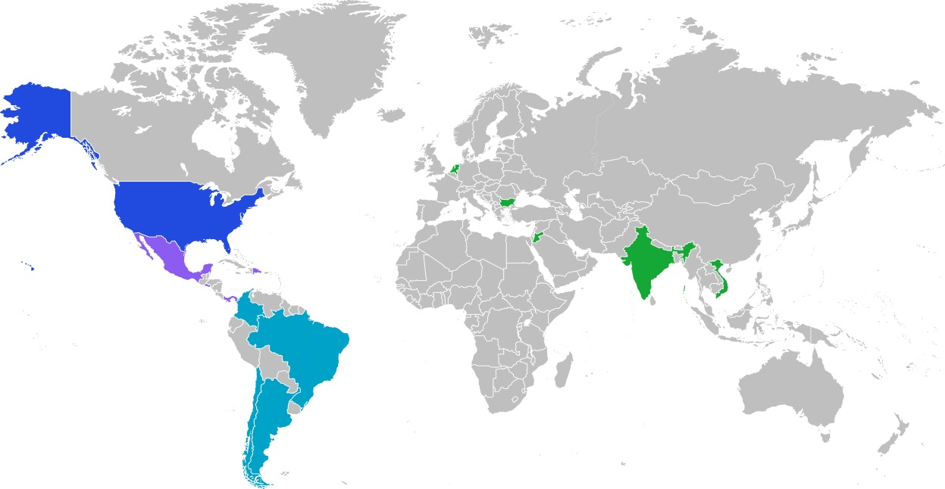
AES Globally
4 Continents
14 Countries
4 Strategic market-oriented business units
6 Utilities
2.5 Million customers served
8450 Global Workforce
Notes:
Challenge at hand:
While many nations and organizations of all types have made admirable commitments to achieve the goal to limit global warming to 1.5 degrees Celsius, we are at great risk of not achieving them if we continue to move at the current pace.
It’s clear – we need to accelerate the pace of change to reach this goal.
We need accelerate the pace of innovation, of deployment, and of scale
That is why AES is taking action to innovate the solutions of the future, today. We are working together with our partners to launch innovative clean energy solutions that enables global decarbonization rapidly and at scale.
If we fail to innovate, then we fail to do our part to improve lives, the environment and climate.
We are a 7-time Edison Award winner from the Edison Electric Institute, the industry’s highest honor, for our contributions to shift and advance the electric industry.

Slide 5
AES U.S. Renewables
9.5 GW Operating Portfolio
  5.4 GW Solar
  2.4 GW Wind
  1.7 GW Battery Energy Storage
53 GW Development Pipeline
1,400+ AES U.S. Renewables workforce
◼︎ Operating
◼︎ Developing

Slide 6
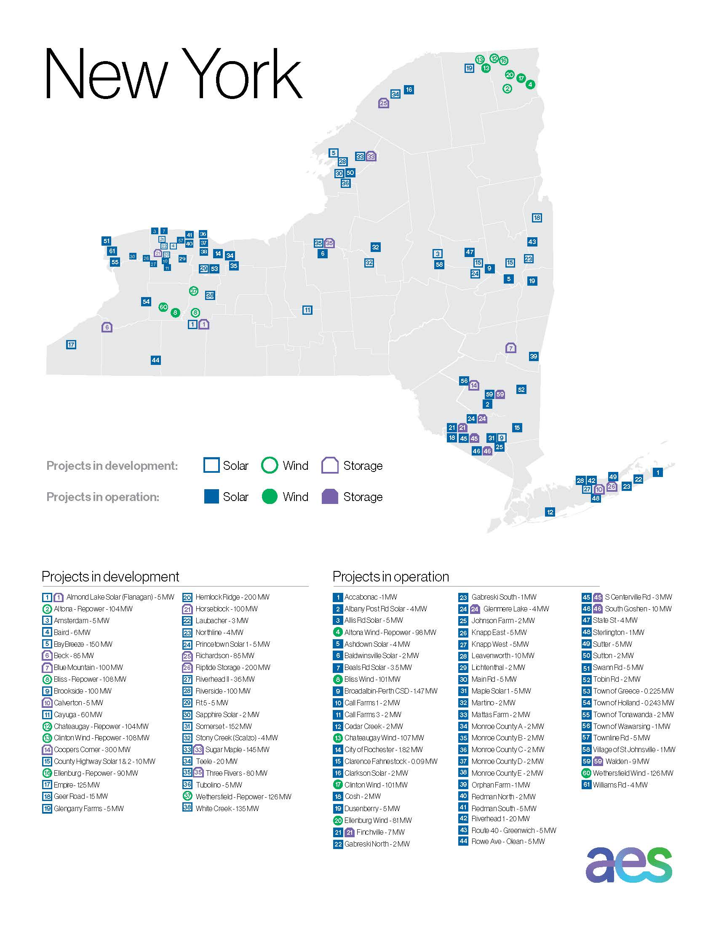
2+ GW in Development
800+ MW In Operation
100+ New York workforce
3 offices

Slide 7

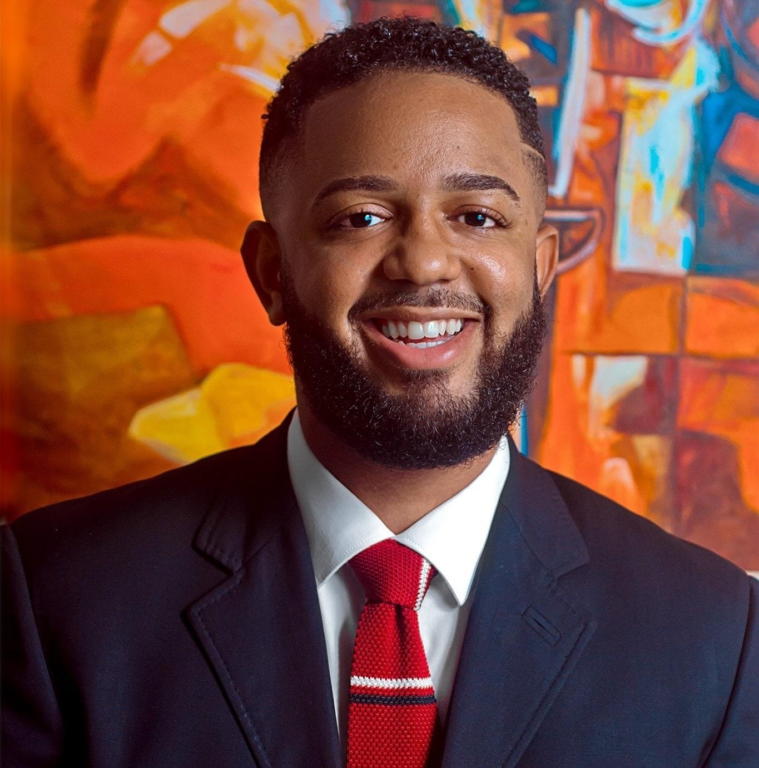


Stakeholder Relations Team
Neely Kelley
Senior Manager, Stakeholder Relations
Matthew Gibbs
Dawit Kiflemariam
Darenne Contreras
Senior Analyst, Stakeholder Relations
Analyst, Stakeholder Relations
Analyst, Stakeholder Relations
Notes:
:30
We support the Stakeholder Relations – Social Impact and Sustainability needs of the organization regionally. Each member of the team, seen on this screen is a resource to help achieve the goals of the organization through relationship development. We are here to help forge mutually beneficial connections and relationships with outside groups and individuals as well as assist with stakeholder related tasks.

Slide 8
The Role of the Stakeholder Relations Team
Outreach and Accessibility
Communications
Social Impact
Monitor project emails
Monitor the state phone line
Community meetings
Open houses
Public hearings
Event sponsorships
Site tours
Memberships: local, regional, state organizations
Developing materials
      Informational sheets
      Handouts
      Display boards
      Presentations
Managing project webpages
Media engagement, in collaboration with AES Comms team at the local/regional/state levels
Supporting high impact initiatives
Goals Align with
    United Nations Sustainable Development Goals
    American Clean Power’s Energy Transition for All Pledge
Notes:
https://cleanpower.org/resources/letter-clean-power-industry-releases-energy-transition-for-all-initiative-to-benefit-workers-communities-and-those-historically-left-behind/
https://www.undp.org/sustainable-development-goals?utm_source=EN&utm_medium=GSR&utm_content=US_UNDP_PaidSearch_Brand_English&utm_campaign=CENTRAL&c_src=CENTRAL&c_src2=GSR&gclid=Cj0KCQjw48OaBhDWARIsAMd966DKw2zU-MUx0TbE81hXnlAy4OlE7FqG582Zok6uh9cmsYEJ4p2jjGIaAieyEALw_wcB#decent-work-and-economic-growth

Slide 9
Overview:
Article VIII permitting timeline and application exhibits for projects >25 MW
9

Slide 10
Article VIII Schedule Overview
Applicant Submits Application
Intervenor Funding Application within 30 days
Completeness Review
60 days
ORES Issues Draft Permit Conditions
60 days
Public Comment Period/Municipal Statement of Compliance
At least 60 days
ORES Issues Determination
Hearings if required
Recommended Decision and Hearing Report
Final Determination 1 Year after completeness
Compliance
Pre-Application Consultations, Studies & Design
Construction
Notes:
Jessica…

Slide 11
Article VIII Siting Application Exhibits
General Requirements
Overview and Public Involvement
Location of Facilities and Surrounding Land Use
Real Property
Design Drawings
Public Health, Safety and Security
Noise and Vibration
Visual Impacts
Cultural Resources
Geology, Seismology and Soils
Terrestrial Ecology
NYS Threatened or Endangered Species
Water Resources and Aquatic Ecology
Wetlands
Agricultural Resources
Effect on Transportation
Consistency with Energy Planning Objectives
Socioeconomic Effects
Environmental Justice
Effect on Communications
Electric System Effects and Interconnection
Electric and Magnetic Fields
Site Restoration and Decommissioning
Local Laws and Ordinances
Other Permits and Approvals
Notes:
Jim…
From Samantha

Slide 12

Thank You
Notes:
Incorporate – getting into the UN – American Clean Power Transition for alls – quantifying and measuring impact – how we report it aligns with SDGs
AES impact report – annual sustainability report, quarterly report to investors, some of the audiences from a reporting perspective -
Outside of NY – we're seeing a lot – customer RFPs - in PPAs, customers requiring us to have asocial impact component – DOE applications, they want to see social impact, past performance and future commitments - It's infiltrating all elements
Need to address externalities -
Customers, regulatory, --these are the drivers
Split between – neely talking about external forces enhanging validating and driving this work - EJ is meeting and exceeding these goals -
Social impact infilitraing our work -
How we're justifying this investment from our company – it's an expense – we're having to justify – but what's helpful is these external forces forcing us to invest - was seen as a'nice to have" now there is demand – companies
This is critical to our business
Moving beyond corporate philanthropy – has been around forever – how can we make a measurable impact – in substantive social impact -
Ultimately we work for the man – we can access capital to make a huge difference -

Slide 13
Thank You
Notes:
Incorporate – getting into the UN – American Clean Power Transition for alls – quantifying and measuring impact – how we report it aligns with SDGs
AES impact report – annual sustainability report, quarterly report to investors, some of the audiences from a reporting perspective -
Outside of NY – we're seeing a lot – customer RFPs - in PPAs, customers requiring us to have asocial impact component – DOE applications, they want to see social impact, past performance and future commitments - It's infiltrating all elements
Need to address externalities -
Customers, regulatory, --these are the drivers
Split between – neely talking about external forces enhanging validating and driving this work - EJ is meeting and exceeding these goals -
Social impact infilitraing our work -
How we're justifying this investment from our company – it's an expense – we're having to justify – but what's helpful is these external forces forcing us to invest - was seen as a'nice to have" now there is demand – companies
This is critical to our business
Moving beyond corporate philanthropy – has been around forever – how can we make a measurable impact – in substantive social impact -
Ultimately we work for the man – we can access capital to make a huge difference -

Slide 14
NY Renewable Energy Permitting
Article 8 and SEQRA
14

Slide 15
Overview of Section 94-c Process
In 2020, New York State introduced a new permitting process for large scale renewable energy projects, the “Section 94-c” process.
Review and decision will be made by the Office of Renewable Energy Siting (ORES) within the Department of State – draft Regulations and Uniform Standards and Conditions (USC) were issued by ORES on September 16, 2020, with a public comment period through December 6, and the final regulations were issued on March 3, 2021.
Provides for election to transition into process for existing Article 10 Projects.
Requires pre-application consultations with state agencies, host municipalities, and meetings with community members.
USCs outline design requirements for large scale projects to standardize design expectations regarding setbacks and potentially sensitive resources. Site specific requirements will also augment the USCs.
Projects must be designed to avoid or minimize, to the maximum extent practicable, potentially significant adverse environmental impacts.
Notes:
Jessica…

Slide 16
Overview of 94-c and Municipalities
ORES must make finding that the project complies with applicable substantive local laws and regulations.
Similar to Article 10, ORES can elect not to apply a local law that is unreasonably burdensome in view of CLCPA targets and environmental benefits of the project.
Requires municipalities to submit a statement of compliance with local laws at least 60 days after issuance of the draft permit.
Local community intervenors and host towns are able to seek intervenor funds
75% of funds reserved for municipalities.
Must apply for funds within 30 days of application filing.
Requires host community benefit.
Notes:
Jim…
Taken from the local agency PPT

Slide 17
The New York regulatory environment
New York is one of the most centrally regulated states for energy policy in the US
  State Climate Goal: Climate Leadership and Community Protection Act (CLCPA)
      70% renewable electricity by 2030
  State Permitting Process: Article VIII
      Renewable Energy Projects > 25MW
  State Procurement: NYSERDA Tier 1
Other Challenges
  Difficult-to-decarbonize sectors like international airports and old housing stock;
  A major metropolitan load center on the Eastern seaboard;
  Transmission constraints;
  Large forestry and farming sectors outside of the metropolitan region;
  A legislature comprised of strong voices, a centralized executive branch/regulatory offices; and
  Strong local voices concerned about renewable siting
Notes:
This is happening all over – we're all doing this – it's the secret sauce. In New York – what we do in SR that adds value to permitting – permitting strict requirements for Community Engagement – strategic giving – specific to NY and give broader explanation of what SR is doing across the country – with goal of building brand – handoff- how that interacts with State gov't relations – success of projects on ground and reputation we're building on the ground – and how that's influencing state policy – legislation, partnerships – NYSERDA, RISE, - then hand off to regulatory – we can influence regulations that make us more competitive -

Slide 18
Timeline: 5 to 8 years
Identify Optimal Site: 6 months – 1 year
  Interconnection – access to the grid
  Flat land
  Wetlands
  Cultural archaeological resources
  Municipal filings/laws
File for Queue position
  $100,000
Site control – 6 to 18 months
  $$$ for manpower
Article VIII Permitting Studies: 2 – 4 years
  $3 - $5 million
Article VIII Permit Submission - $1000/MW submission fee: 1 – 2 years
  4 – 6 months until deemed complete
  Deficiencies - $200,000 – response to deficiencies
  1 year between completeness and decision by ORES
Post permit filings
Construction: ~1 year
Notes:
Identify Optimal Site
Interconnection – access to the grid – good interconnection – analysis – upgrade cost to interconnect -
Flat land
Wetlands
Cultural archaeological resources
Municipal filings/laws
File for Queue position –$100,000 –
reserve a spot on the grid - have to show at least a letter of intent - site is the case over the last few years
Hydrology - mapping storm water – and where it flows – wet parts of site –poorly – technical parts that inform the design and inform som e of the design which is an exhibit
Site control -
Land campaign/knock on doors talk to landowners - 1+ years to get a landowner on board- hundreds of thousands of dollars – just man power to knock on doors – calls, emails, attorneys, back and forth – 100MW – 3 landowners – 6 months to 18+months
90% site control then,
94c Permitting Studies
Wetland, sound, T & E, traffic studies, geo tech, hydrology and more
$3 - $5 million -– for all studies – 2.5 for white creek - 3 – 4million dollars for permit and design, filing fee is $1000/MW
Permit Approval extent of deficiencies - $200,000 – response to deficiencies -
Morris ridge – NTP -
We could 800 MW and COD by 2026 – starting
Nothing they can do to expedite this process - - they can't drive a bulldozer any faster – they will go to same EPCs and same contractors with less money – everybody fights for budget -
Capx ex - $200,000,000 - $300,000,000
They aren't naïve to development – they aren't doing it at this scale – 15 to 20 developers doing this as quickly and -
NYPA not incentivezed
Allocate funds to – incentivize brownfield developers – funding for interconection – more expensive – in
94c – it is working – they are permitting projects (are they buildable or not) started in 2021 – 4-6 years – 2021 – got it's legs (ORES) 4-6 years – 24 just
2030 might hve been a tough aggressive – levers to help us get -

